Slide 1
Howard Ball Residence Restoration
Presented by Ruth & Jack Ham
April 29, 2018

Slide 3
Ruth grew up in Midland and came to know Alden Dow homes as a child.
Her Dad built an Alden Dow designed home on Applewood Rd in 1950’s
Later her Mom stripped all of paint off the oak trim on a colonial home on West Park Drive and then restored a Mid-century modern home on Leeway Dr. to its original condition.
We have owned four homes in our married life and renovated – to some degree all of them.
None as challenging or rewarding as the Howard Ball residence

Slide 4
OUR VISION
One thing we feel we have learned about Mr. Dow’s design philosophy is that although he had his style, he also felt the home owner should have some say and independence in design decisions as well.
Some people like painted wood work and more color – our vision was to bring back the beauty of the natural wood as much as possible throughout the inside and outside, and to mute some of the colors in the other finishes.
Instead bring those colors back with furnishings

Slide 5
INTERIOR CONDITIONS/PRIORITIES
We purchased the home in May 2016.
All of the woodwork in both second floor bedrooms, the living room, dining room, and den had been painted to some degree.
The living room and second floors rooms were carpeted (as they originally were), but had douglas fir flooring beneath.
Ruth began on the second floor stripping all of the wood work, while living on the first floor.
Ruth did some work on the outside in the summer, then returned to the finish the second floor through the winter of 2016/17
Last April we again moved outside and worked on the den and dining room intermittently.
In late summer we replaced all of the living room windows and then completed the living room over the winter.
We’ll move outside and hopefully complete the outside this summer and fall

Slide 6
Inside Paint Refinishing Process
For the inside woodwork, I used a combination of chemical stripping and sanding to remove the existing paint or stain.
JASCO Premium Paint and Epoxy Remover JASCO was applied to the painted wood surfaces, wait for it to bubble up then scrape it off, keep going until you can’t get any more off. Be careful not to gouge the wood. Fir is easy to gouge.
Stripping wood should be done during warm weather. You must have cross ventilation. We used fans to bring air in and out across the work area. Wear a mask inside and heavy gloves. If your hands begin to tingle, change gloves. This chemical evaporates
After completing the stripping – I used an orbital sander to complete the preparation – starting with 40 grit, then 80, 120, 150 and 200.

Slide 7
Inside Paint Refinishing Process
With the upstairs windows in the hall we had to cut the nails with a small saw, remove the trim and clean and sand it; because the lines of white paint would not come off otherwise. This worked well and we continue to do it whenever we need to.
For the finish we chose a water base polyurethane, Benjamin Moore’s Benwood Stays Clear Acrylic polyurethane. I used flat to minimize the sheen.
I applied 3 to 4 coats, lightly sanding between coats. I have used both brush on and wipe on with a clean cloth. For applying the finish.

Slide 8
Master Bedroom

Slide 9
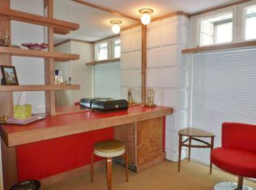

Slide 10
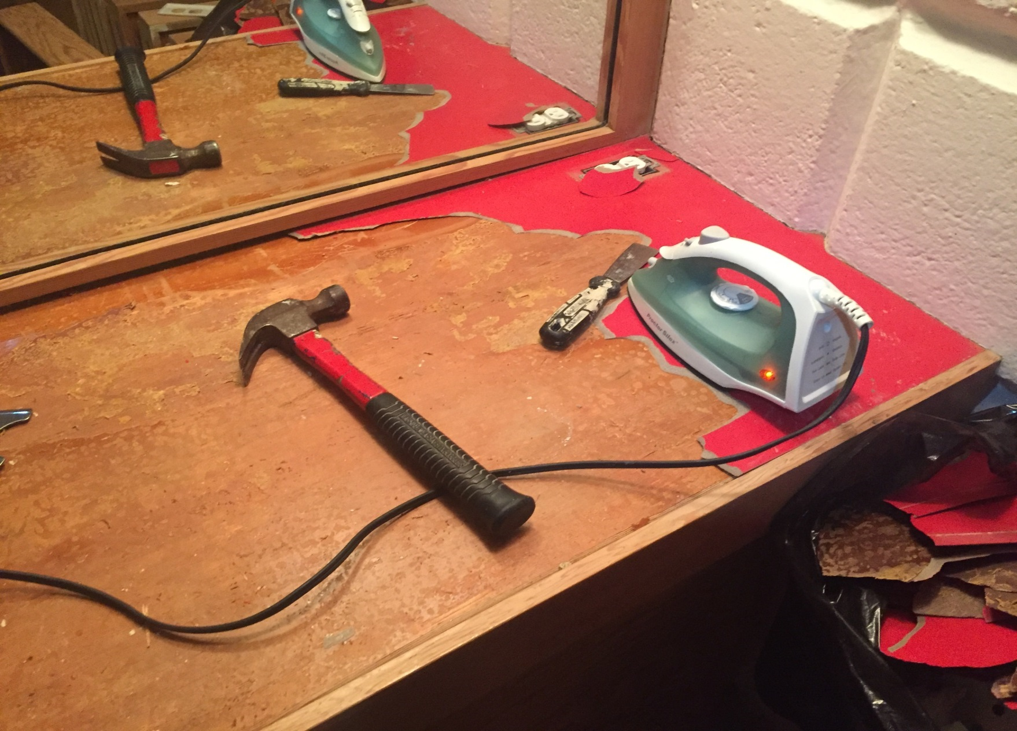

Slide 11
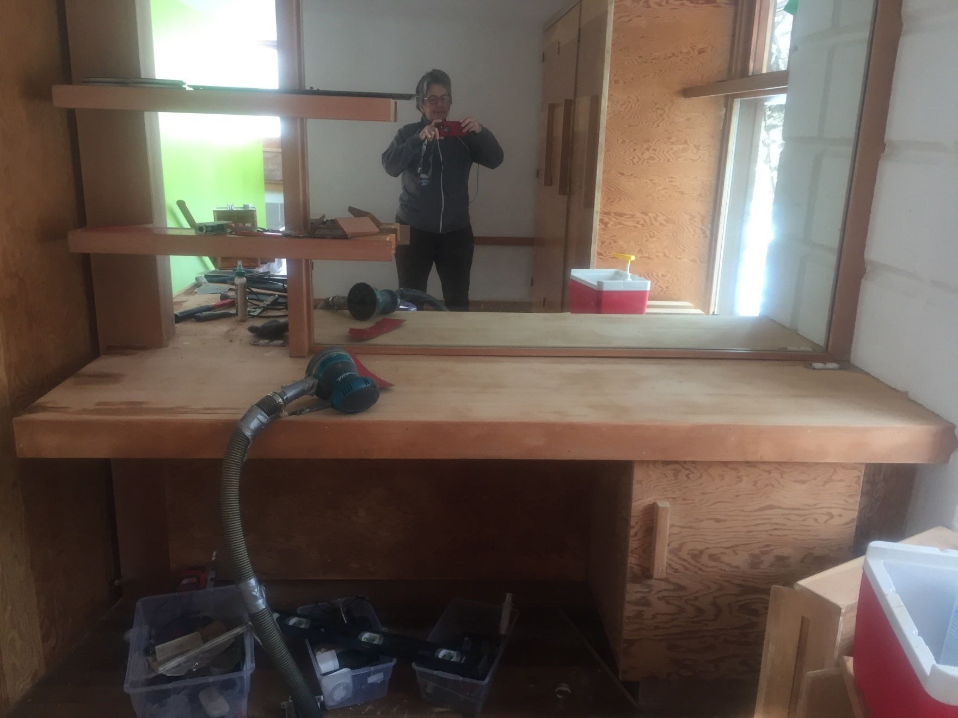

Slide 13
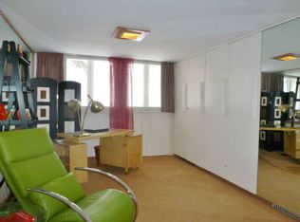

Slide 14
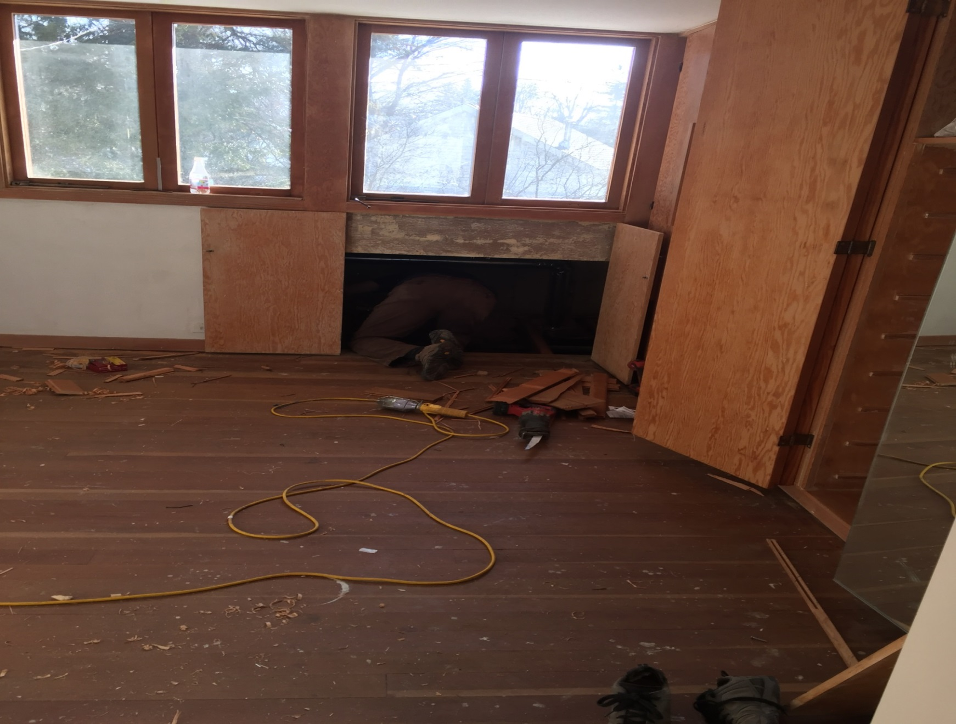

Slide 15
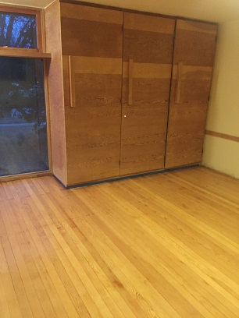

Slide 16
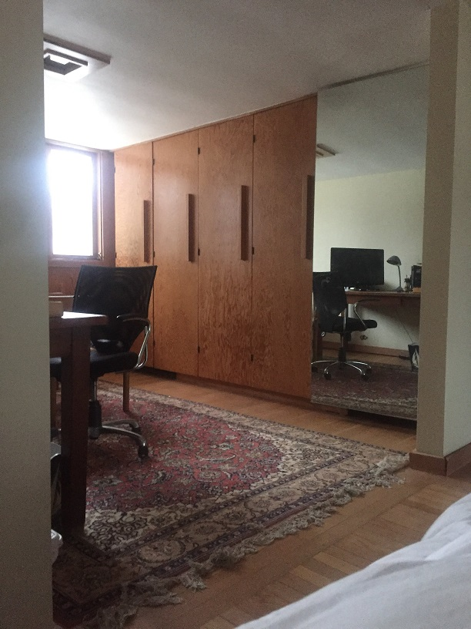

Slide 17
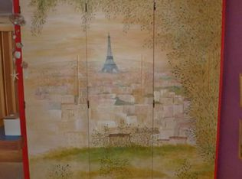
Second Bedroom Upstairs

Slide 18
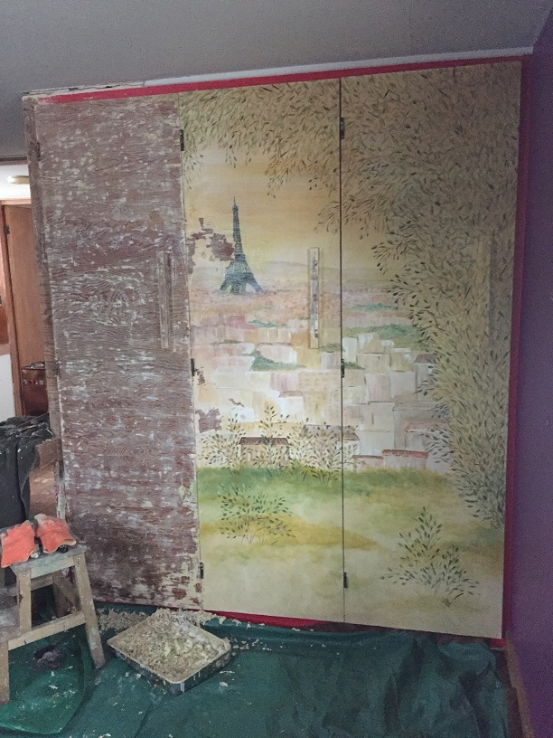

Slide 19
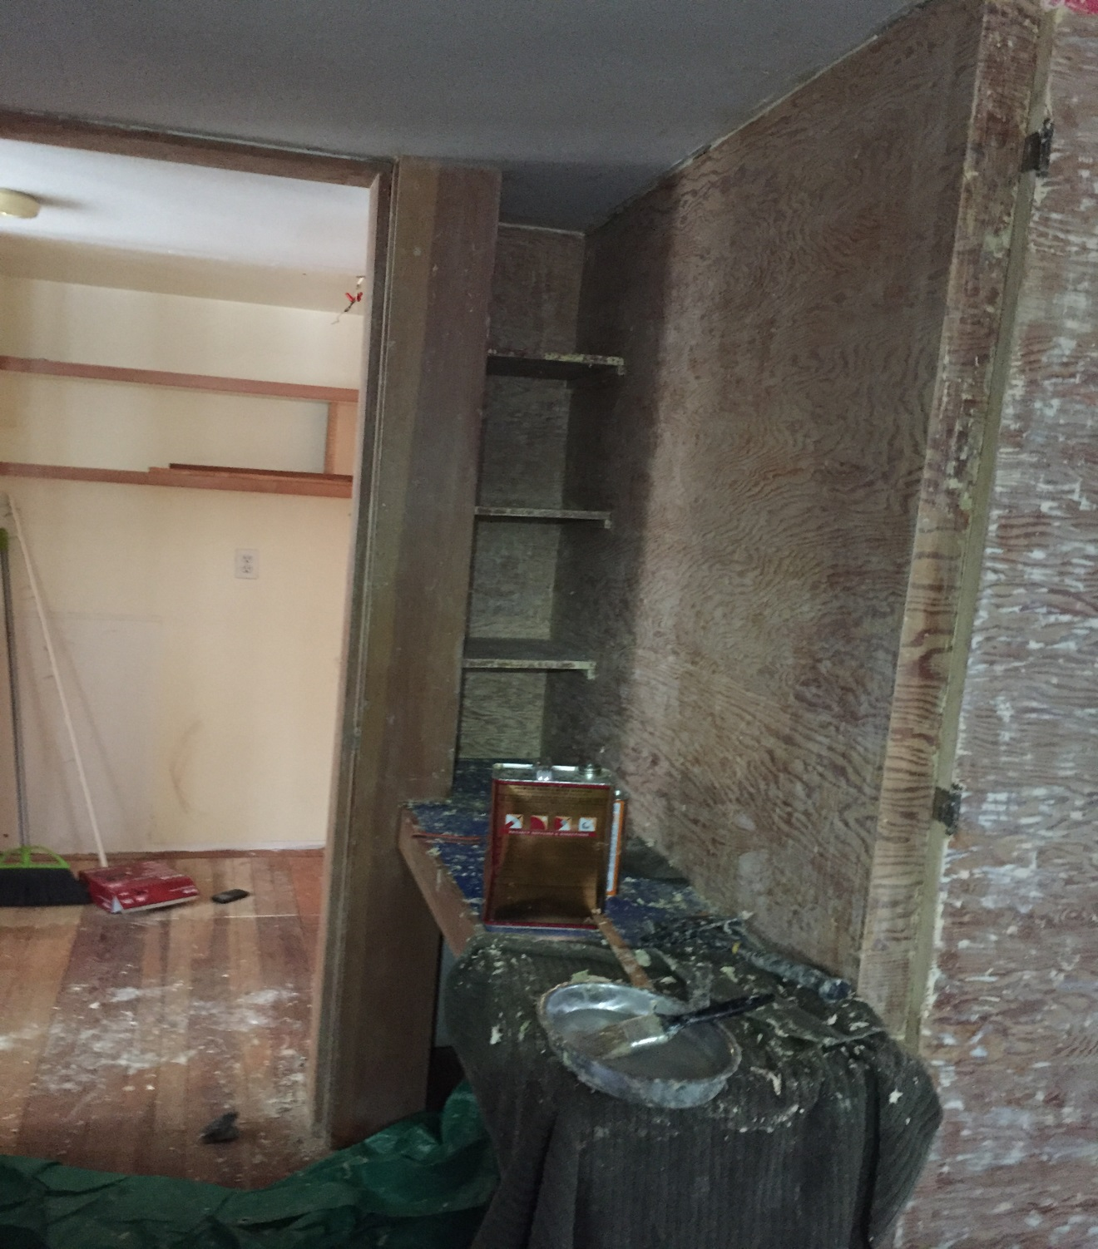

Slide 20
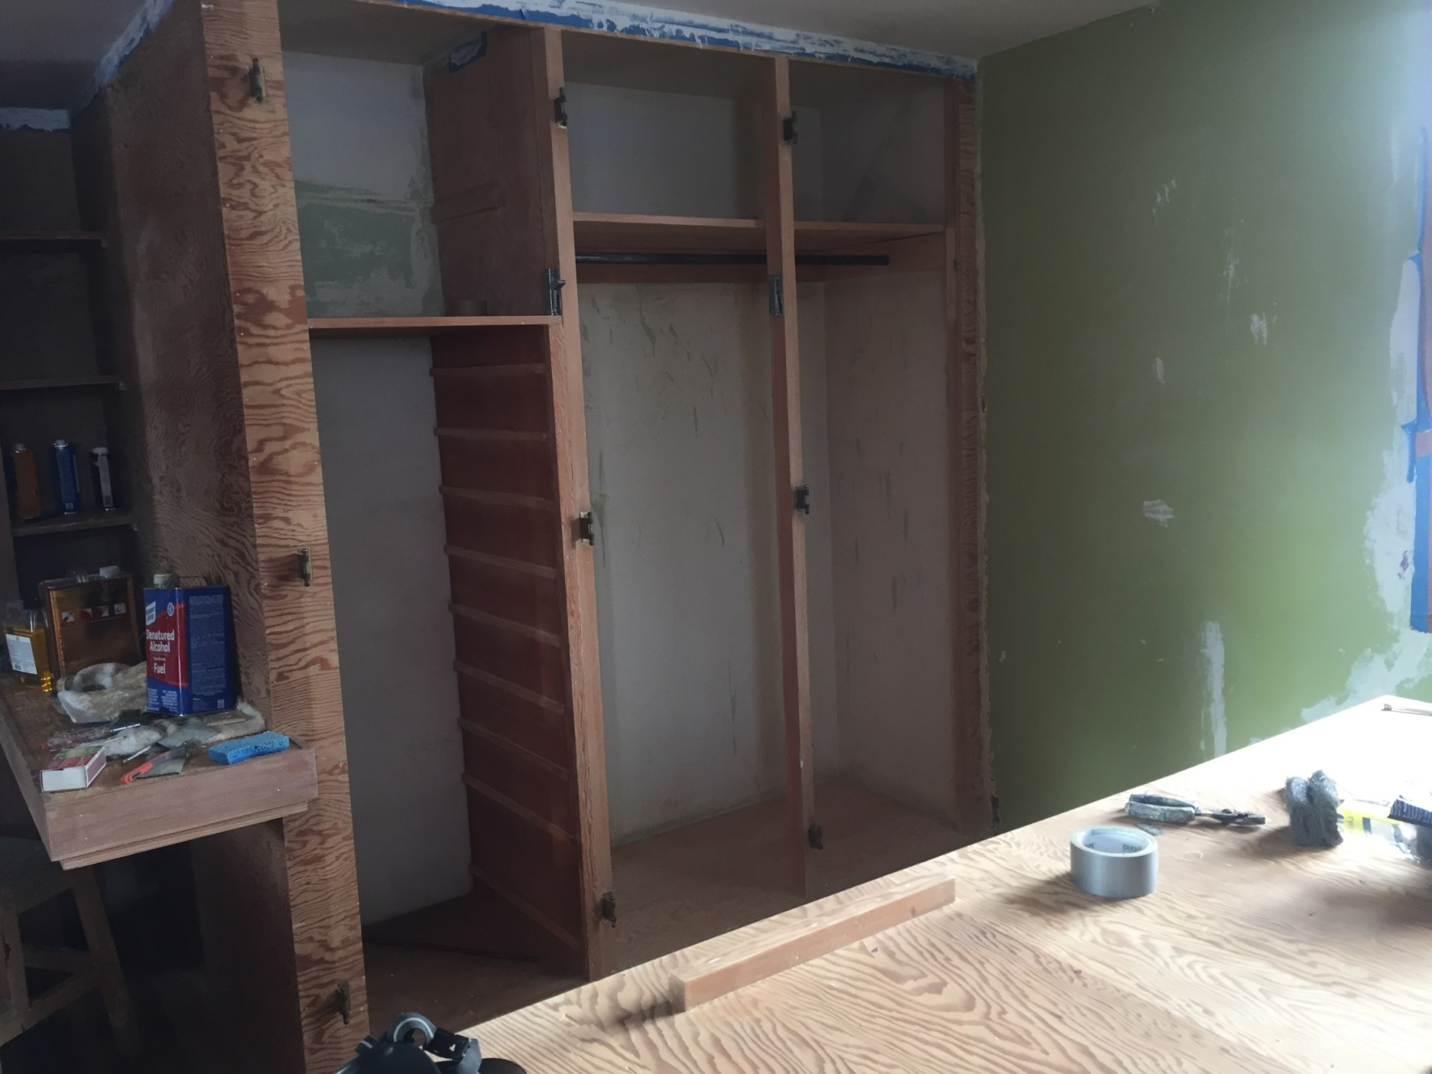

Slide 21
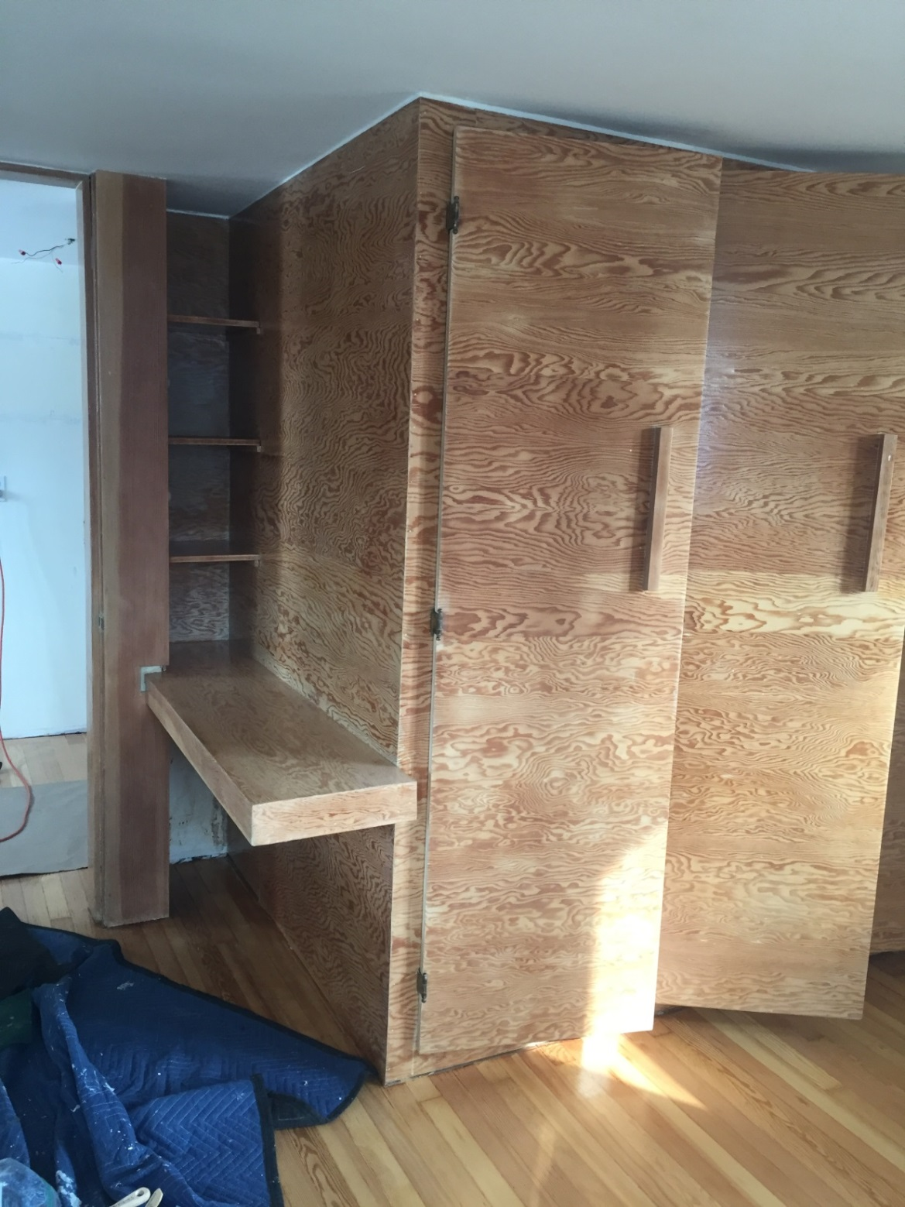

Slide 22
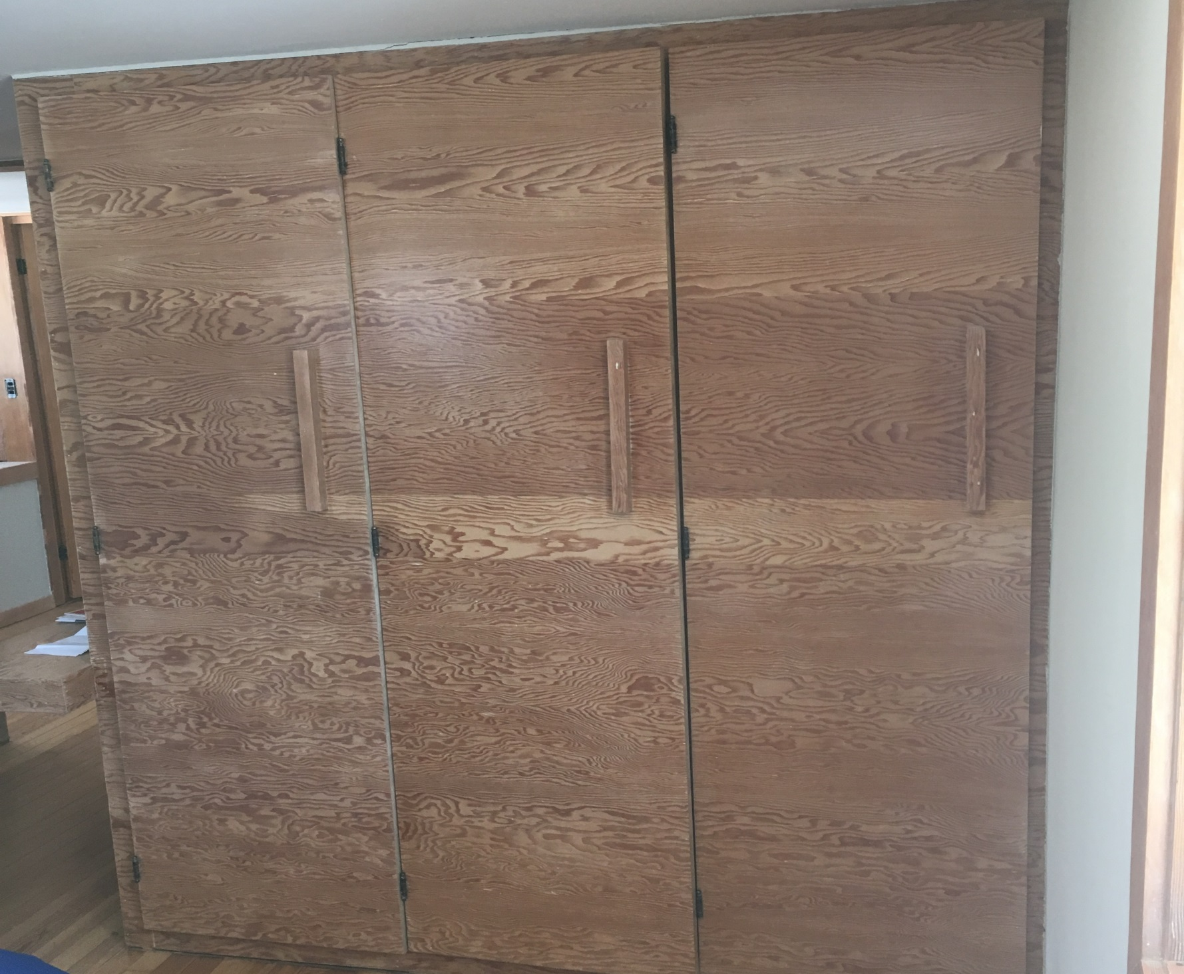

Slide 23
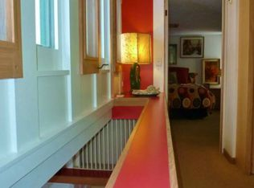
Second Floor Hallway

Slide 24
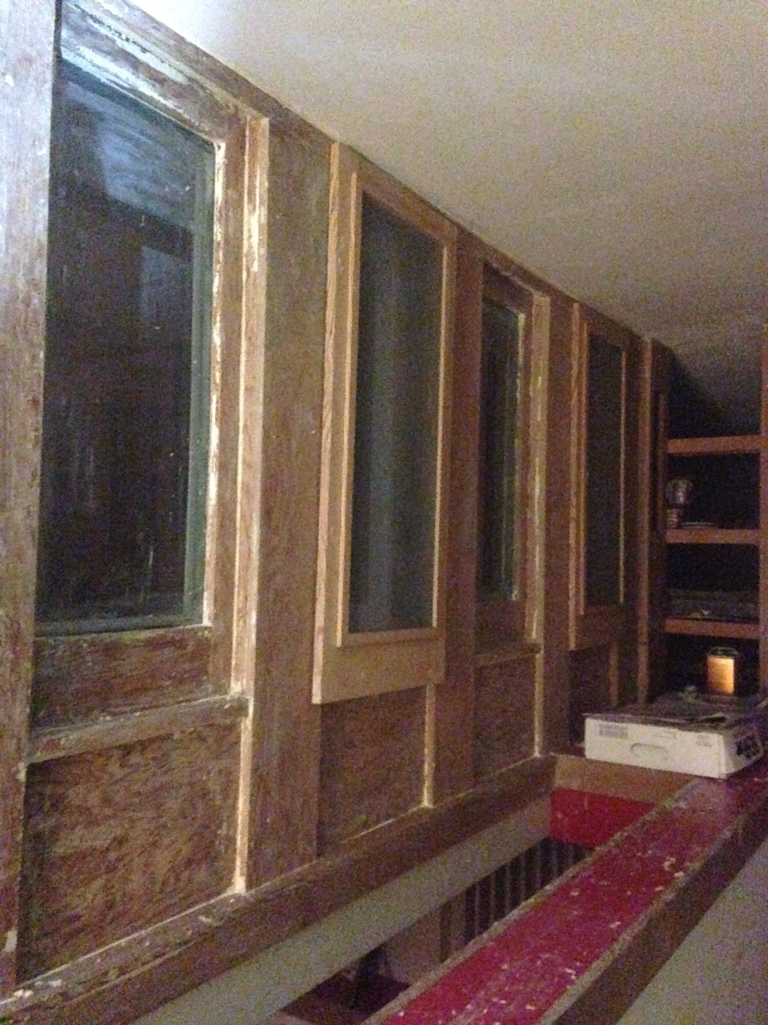

Slide 25
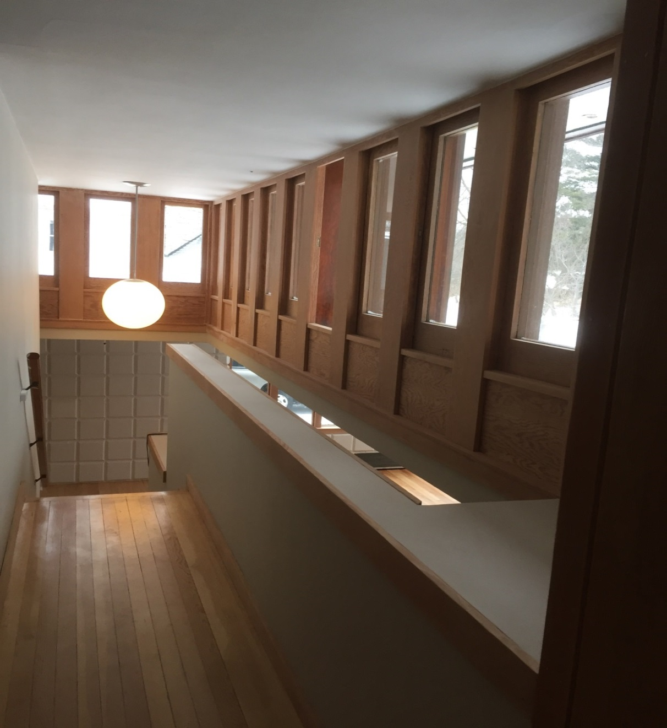

Slide 26
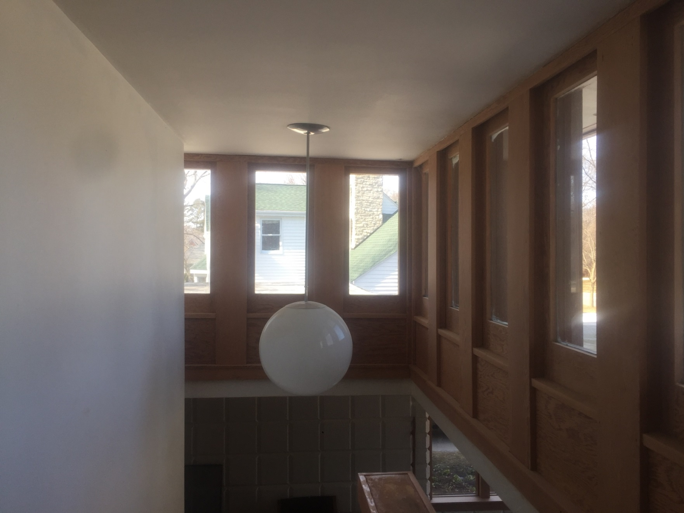

Slide 27
Living Room Projects
The Living Room is where we have done the most number of projects.
In addition to stripping paint from the wood trim we have
Refinished the Douglas fir wood floors
Replaced brick tile Hearth and entry way
Stripped paint from a large louver
Replaced the living room windows on the north and west side of the room

Slide 28
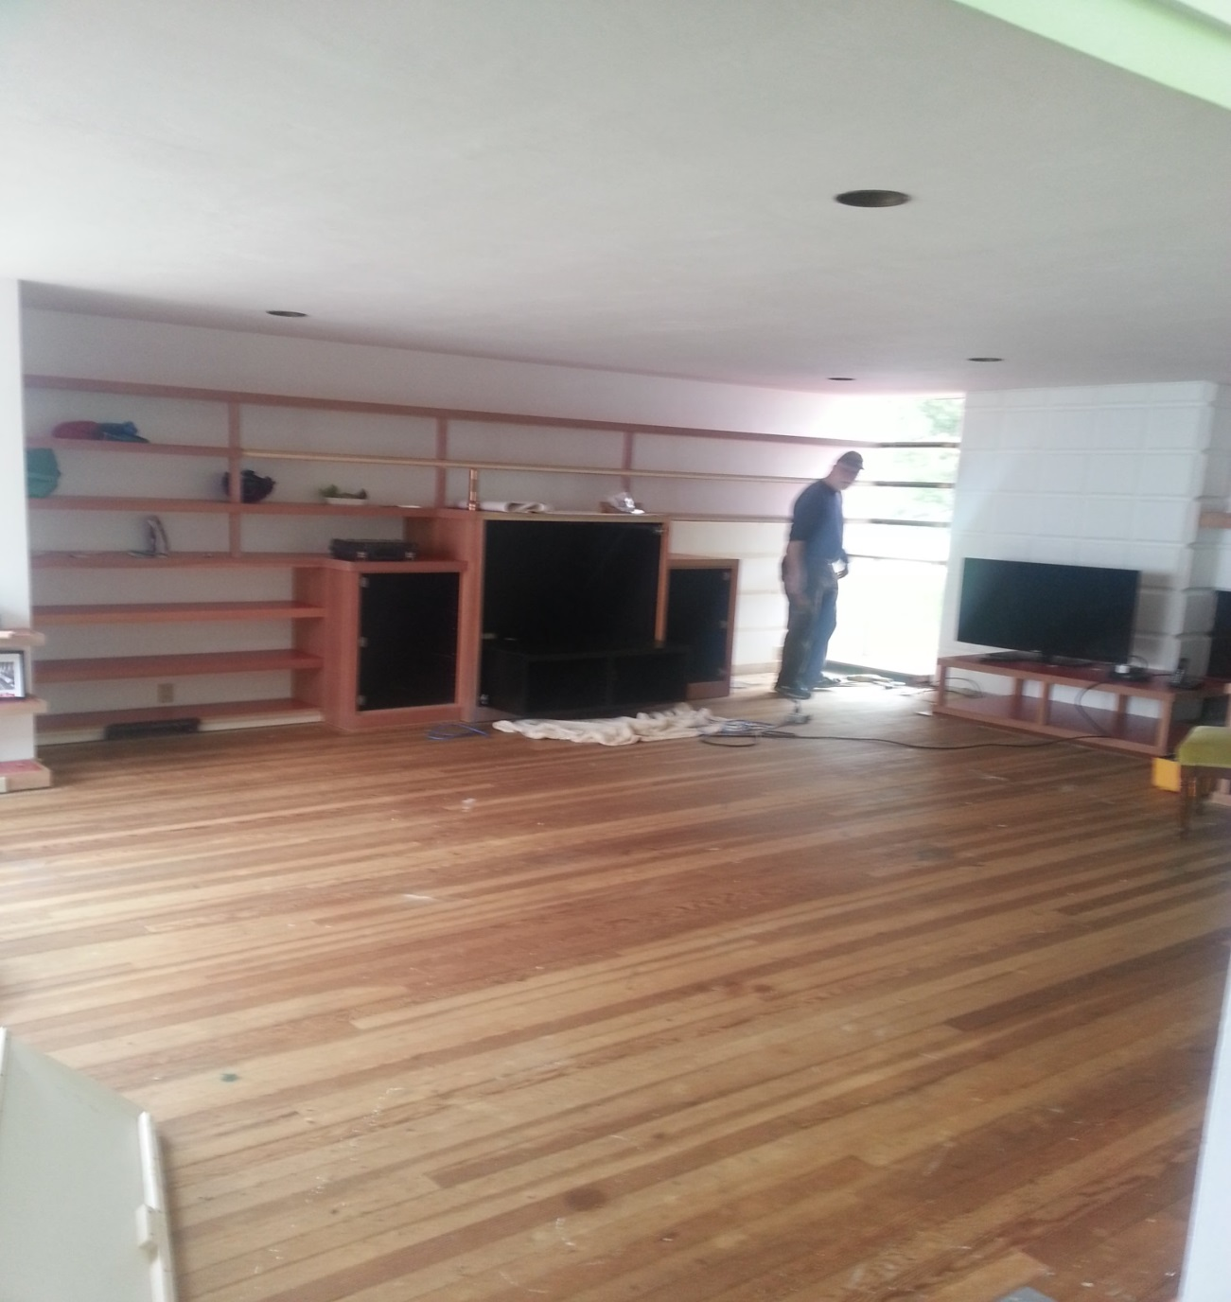

Slide 29
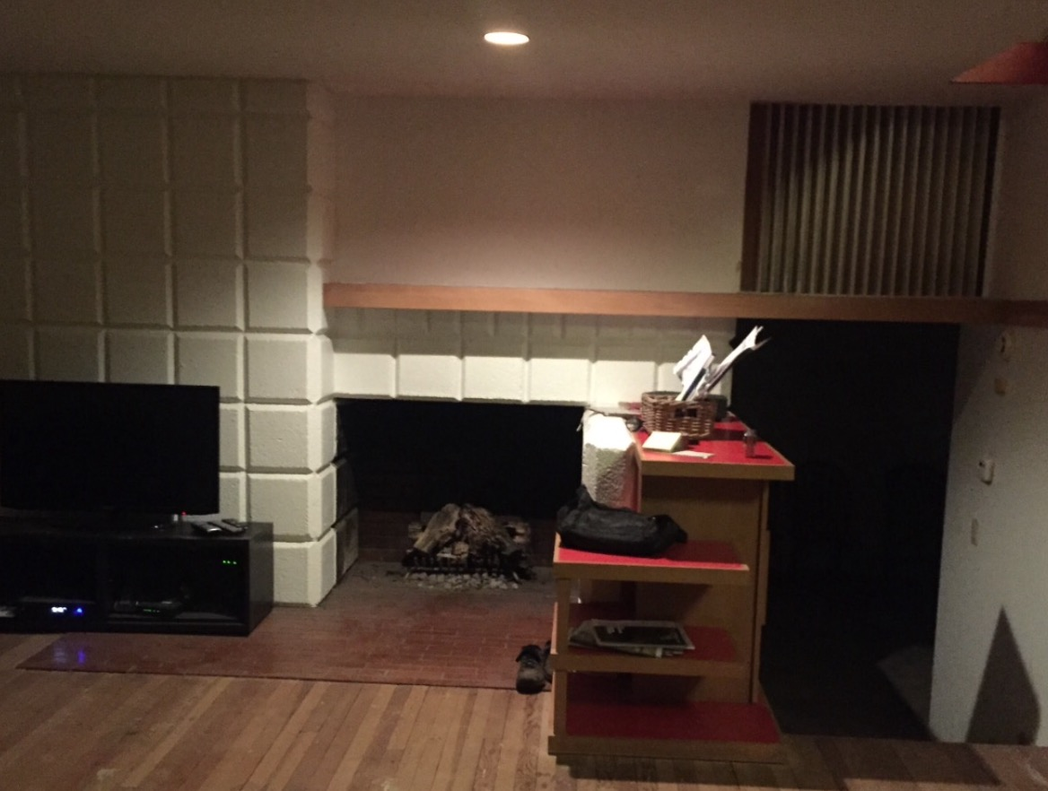

Slide 30
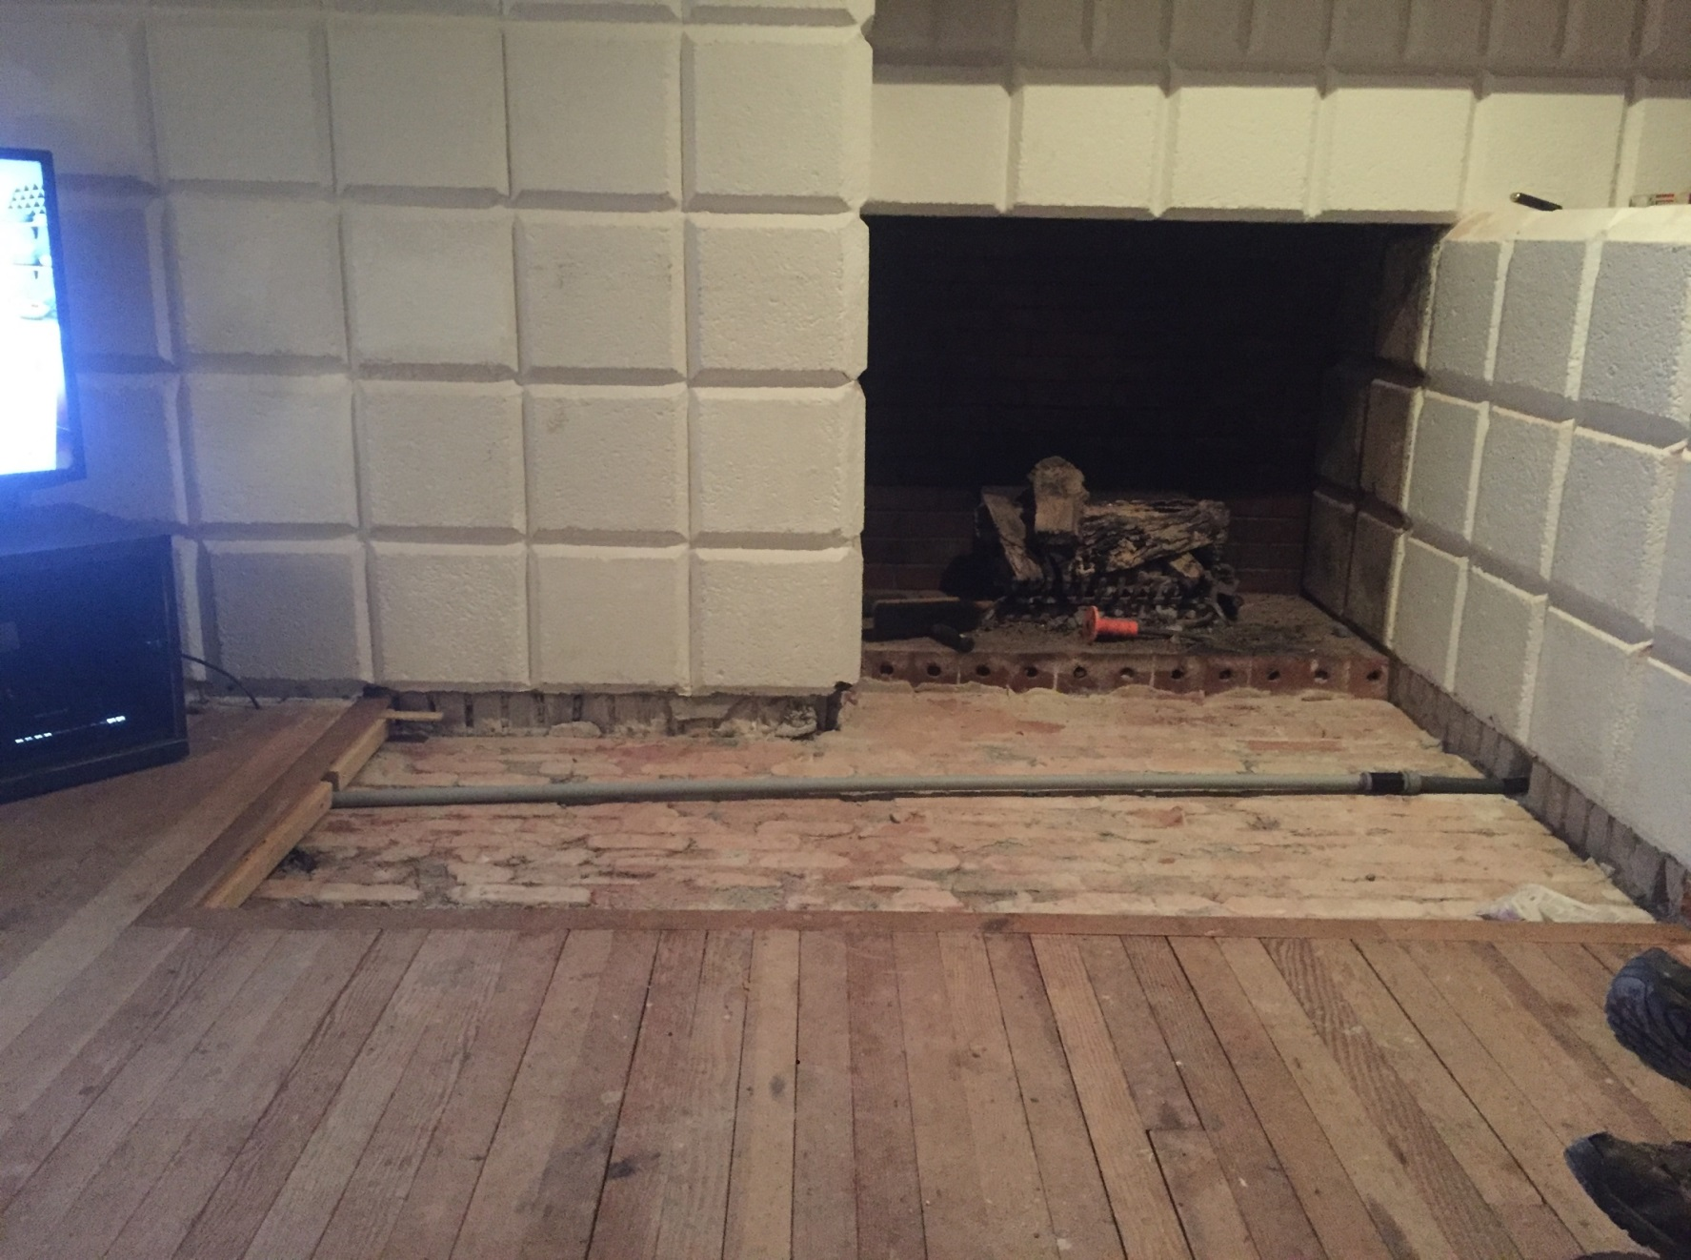

Slide 31
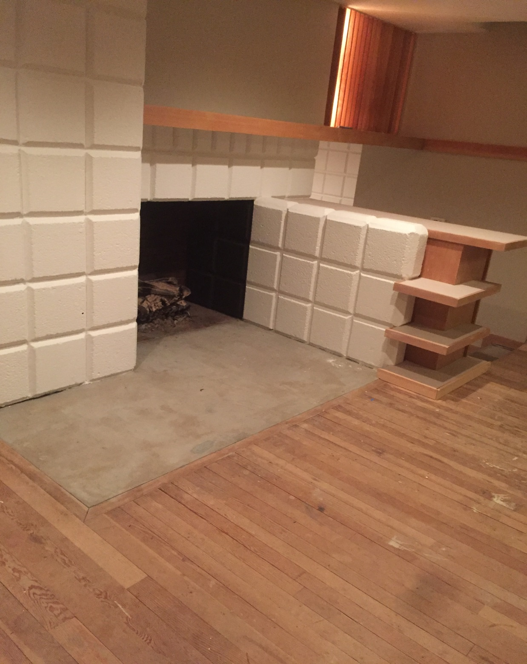

Slide 32
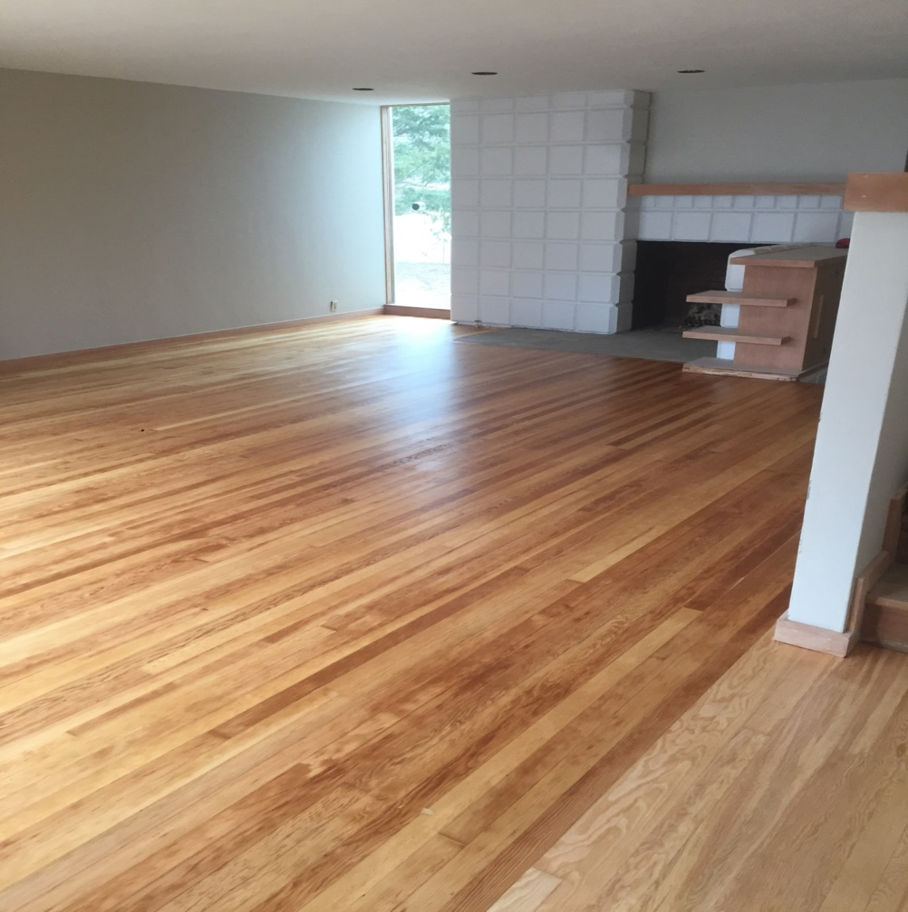

Slide 33
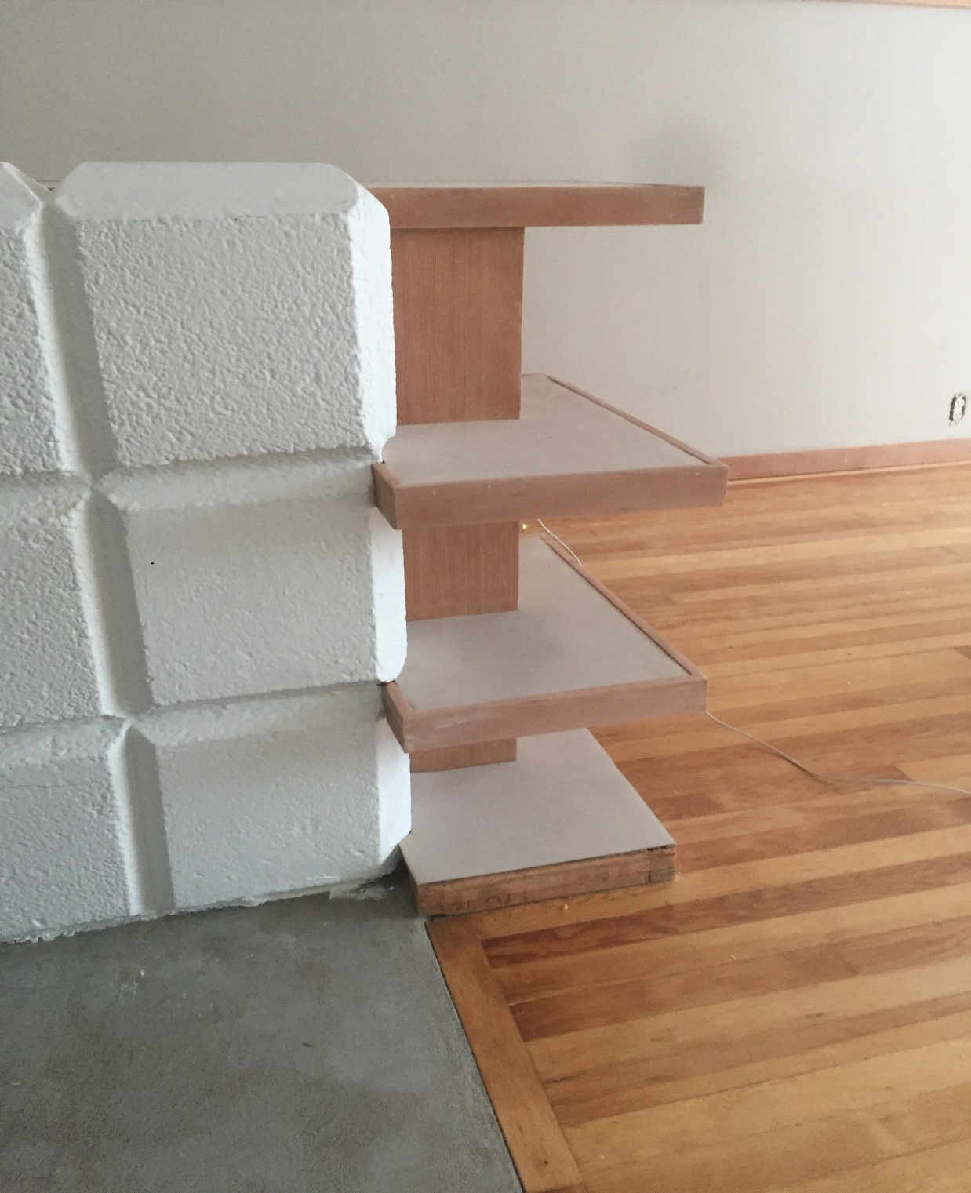

Slide 34
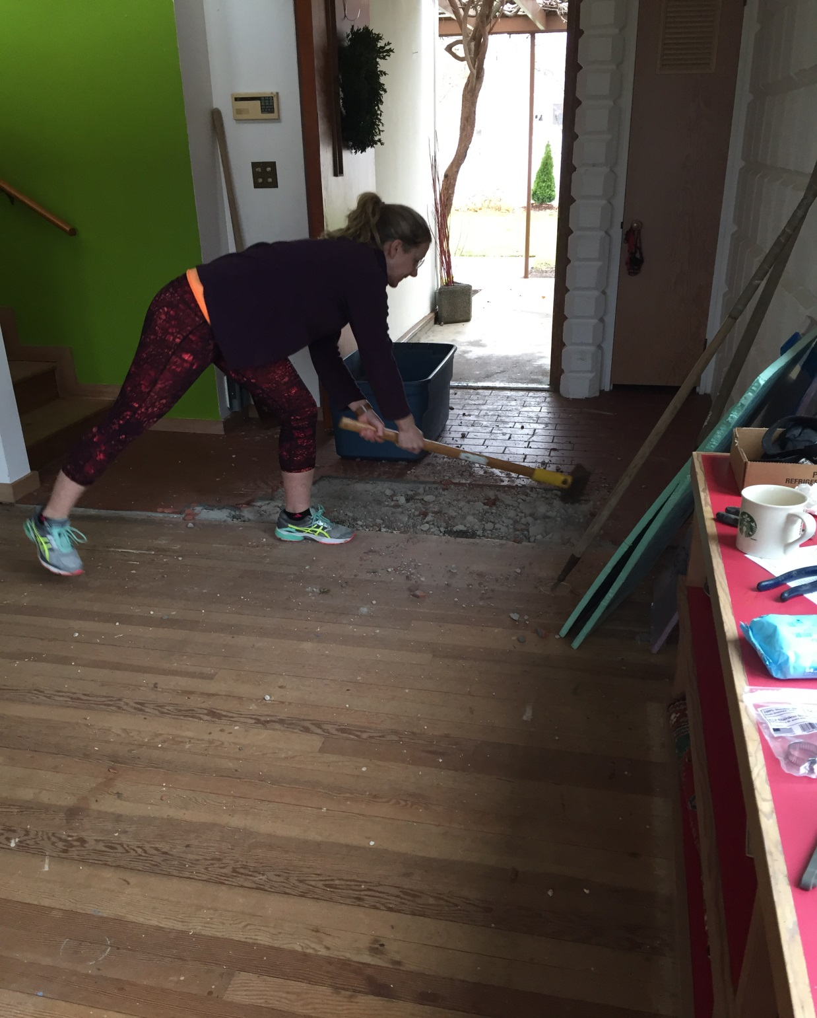

Slide 35
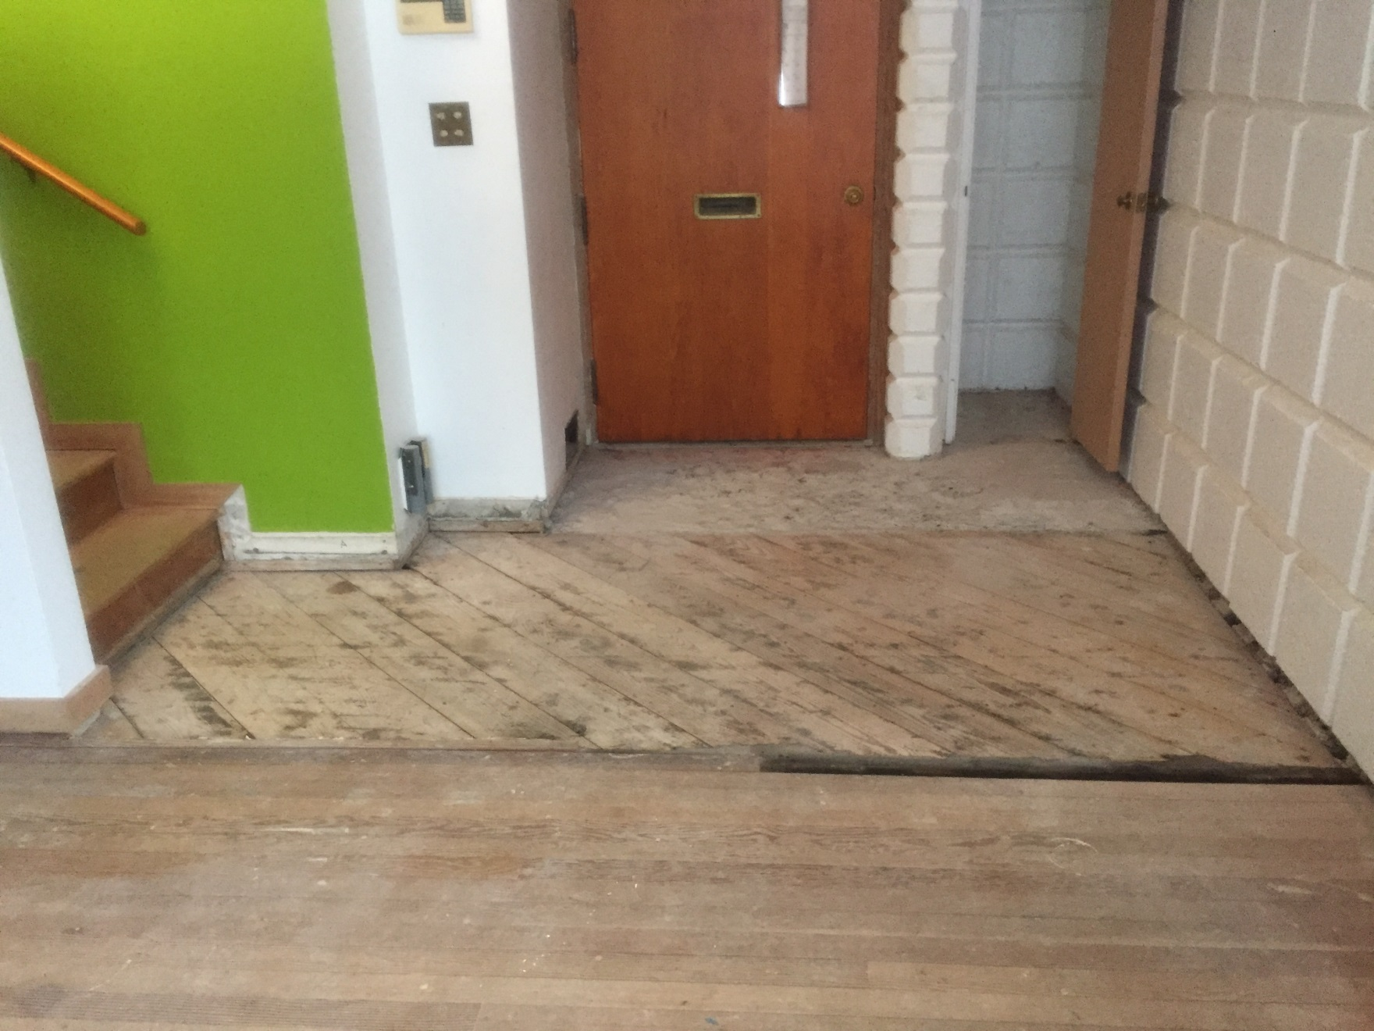

Slide 36
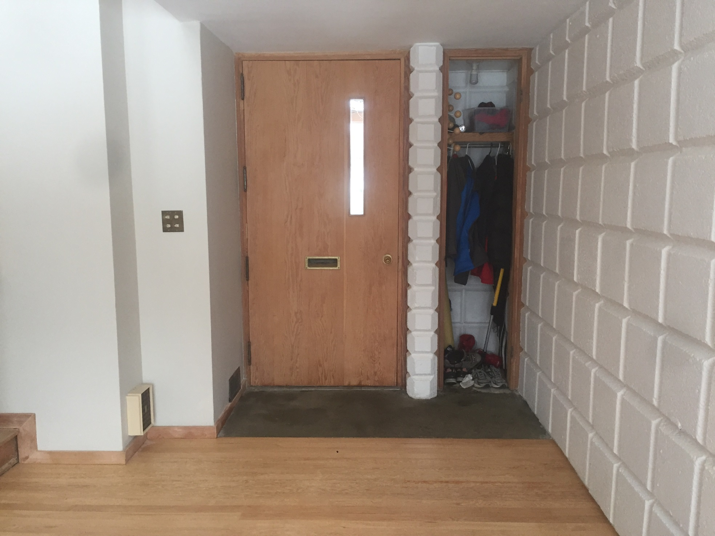

Slide 37
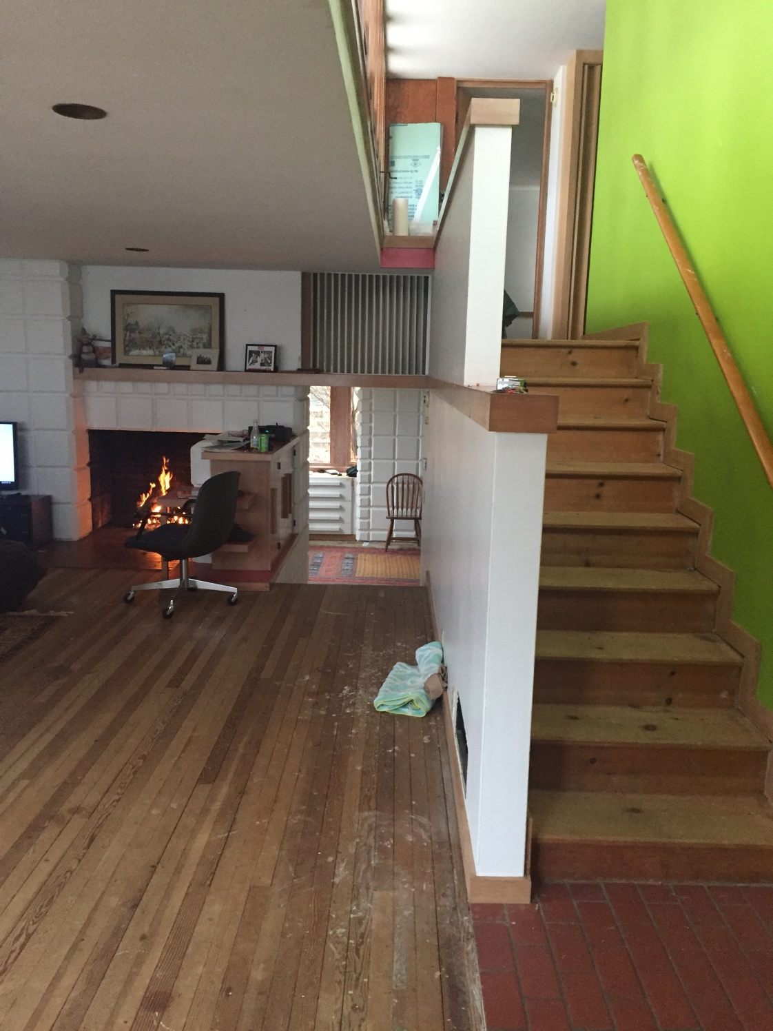

Slide 38
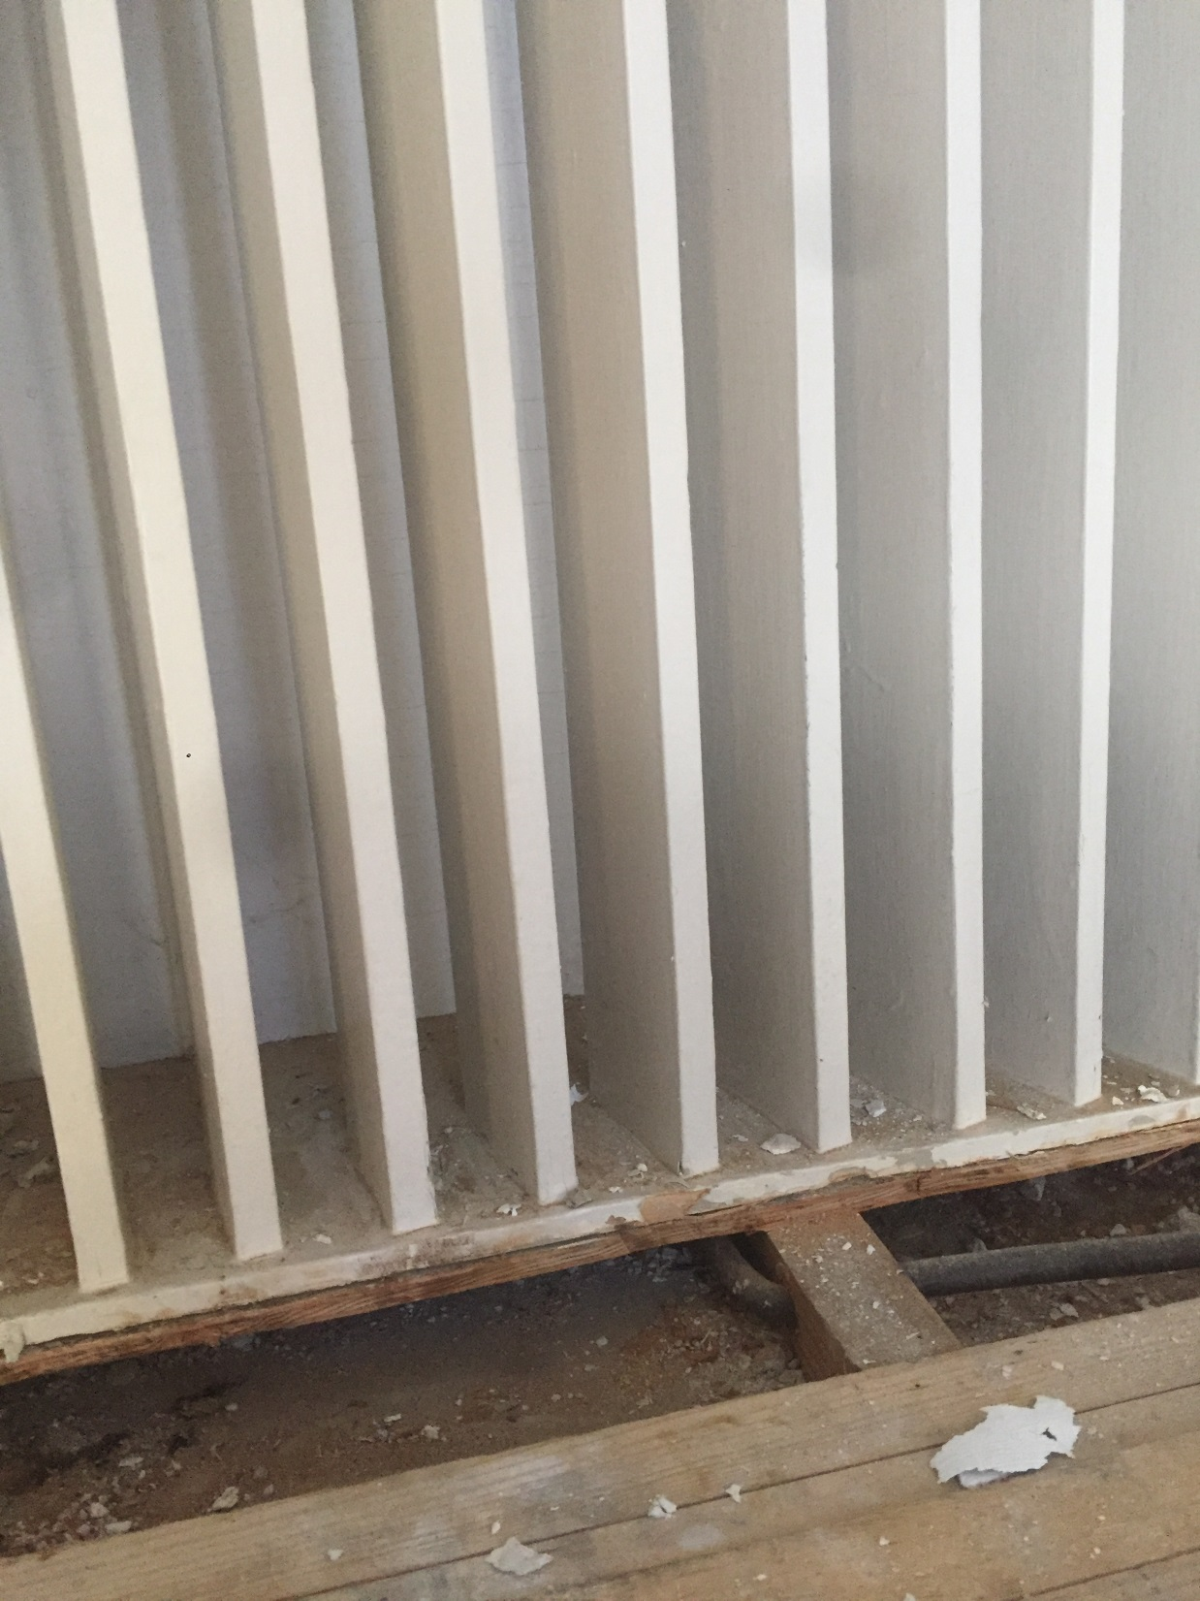

Slide 39
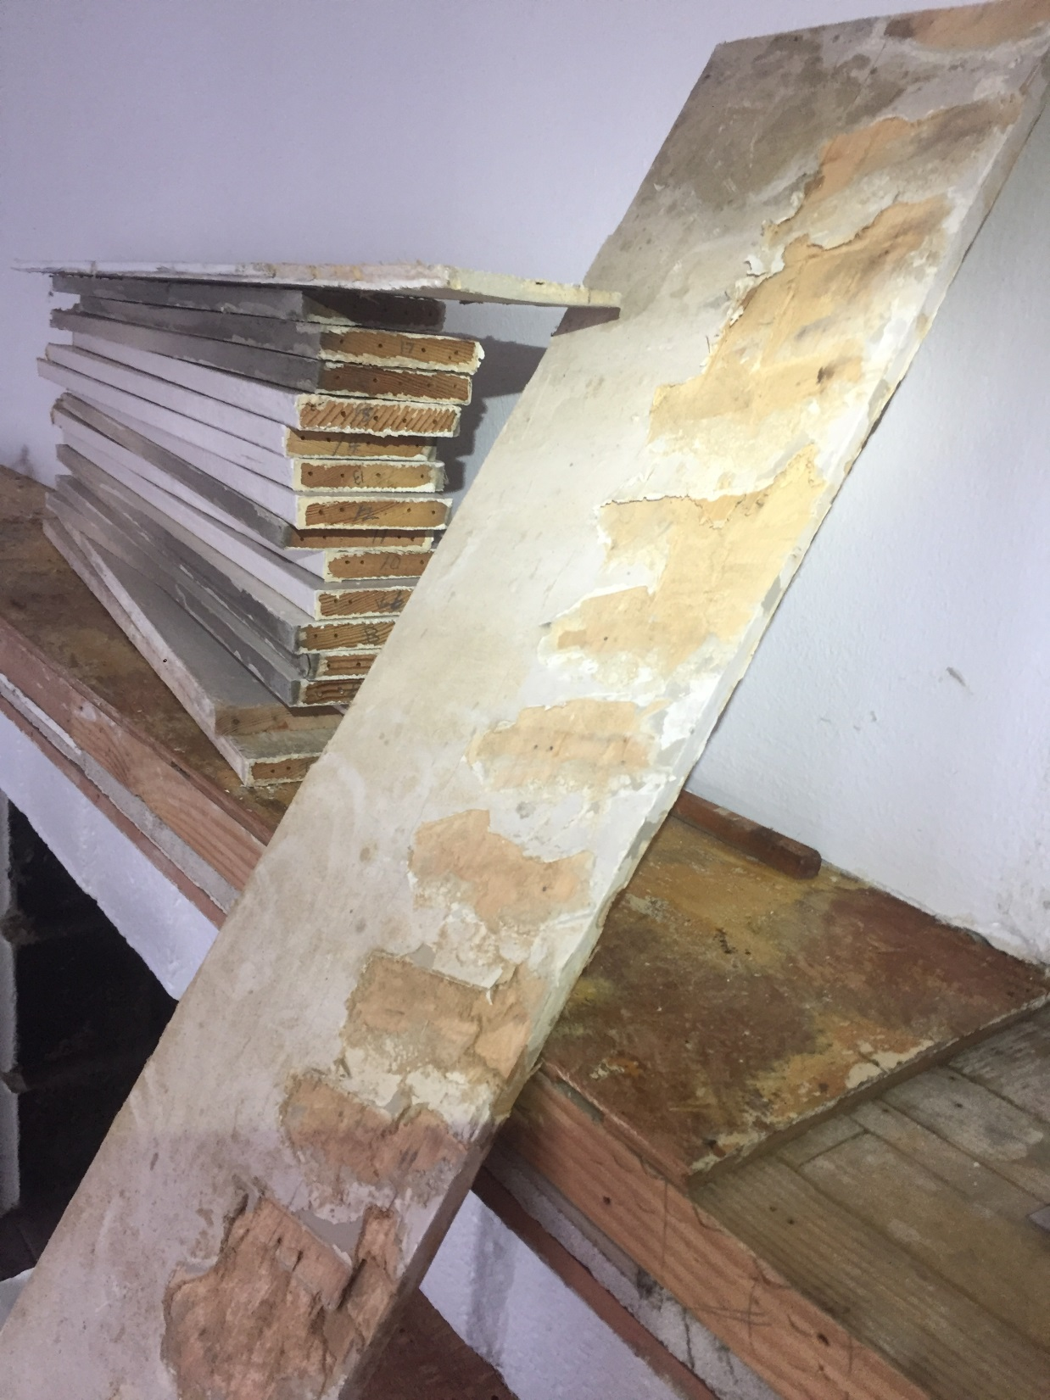

Slide 40
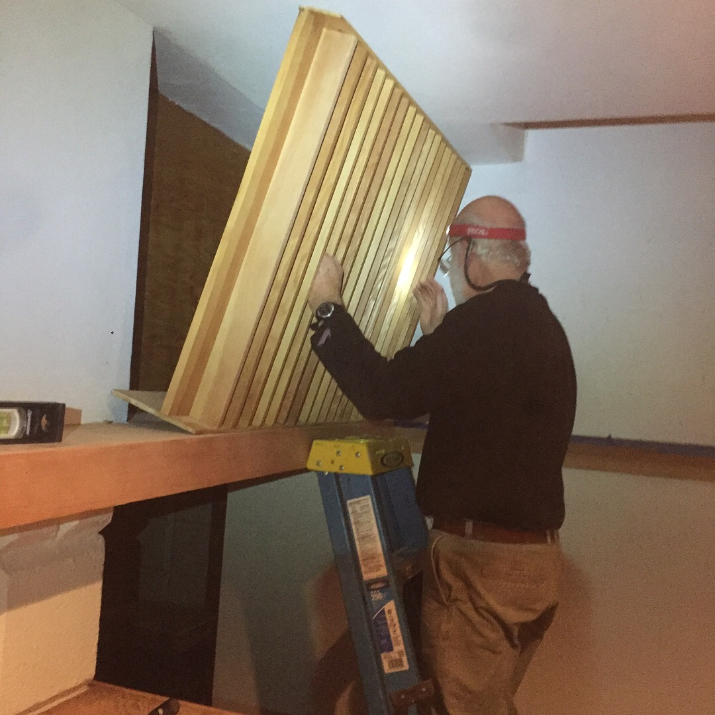

Slide 41
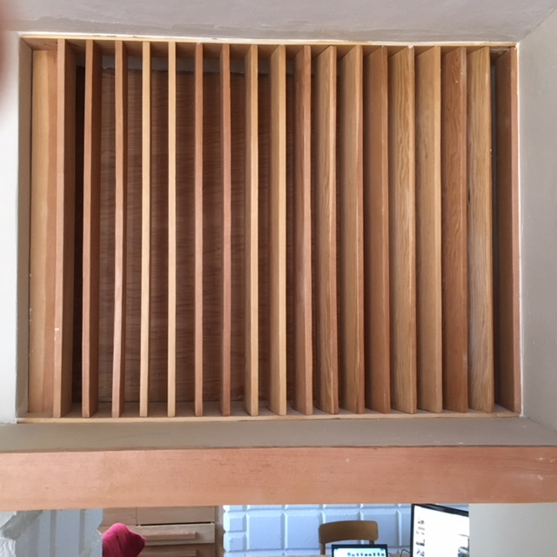

Slide 42
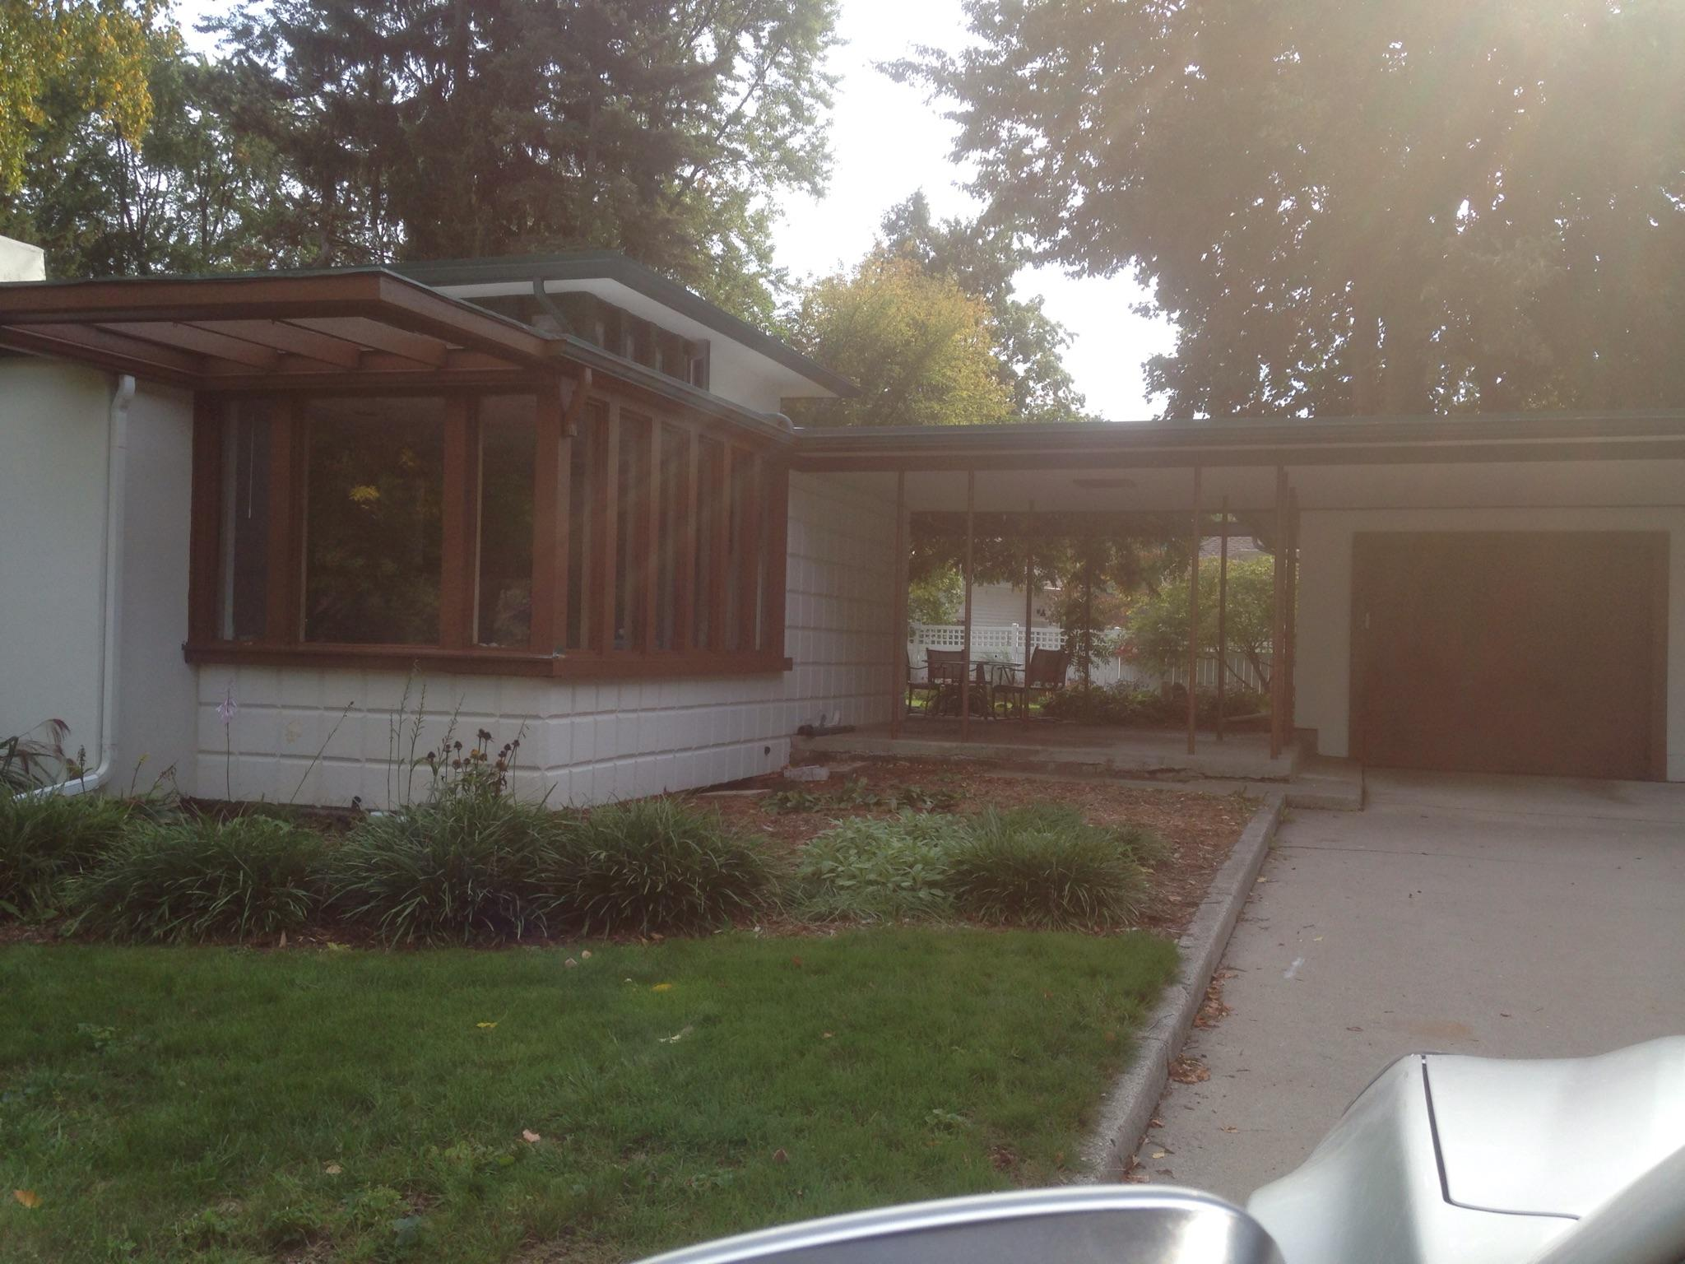

Slide 43
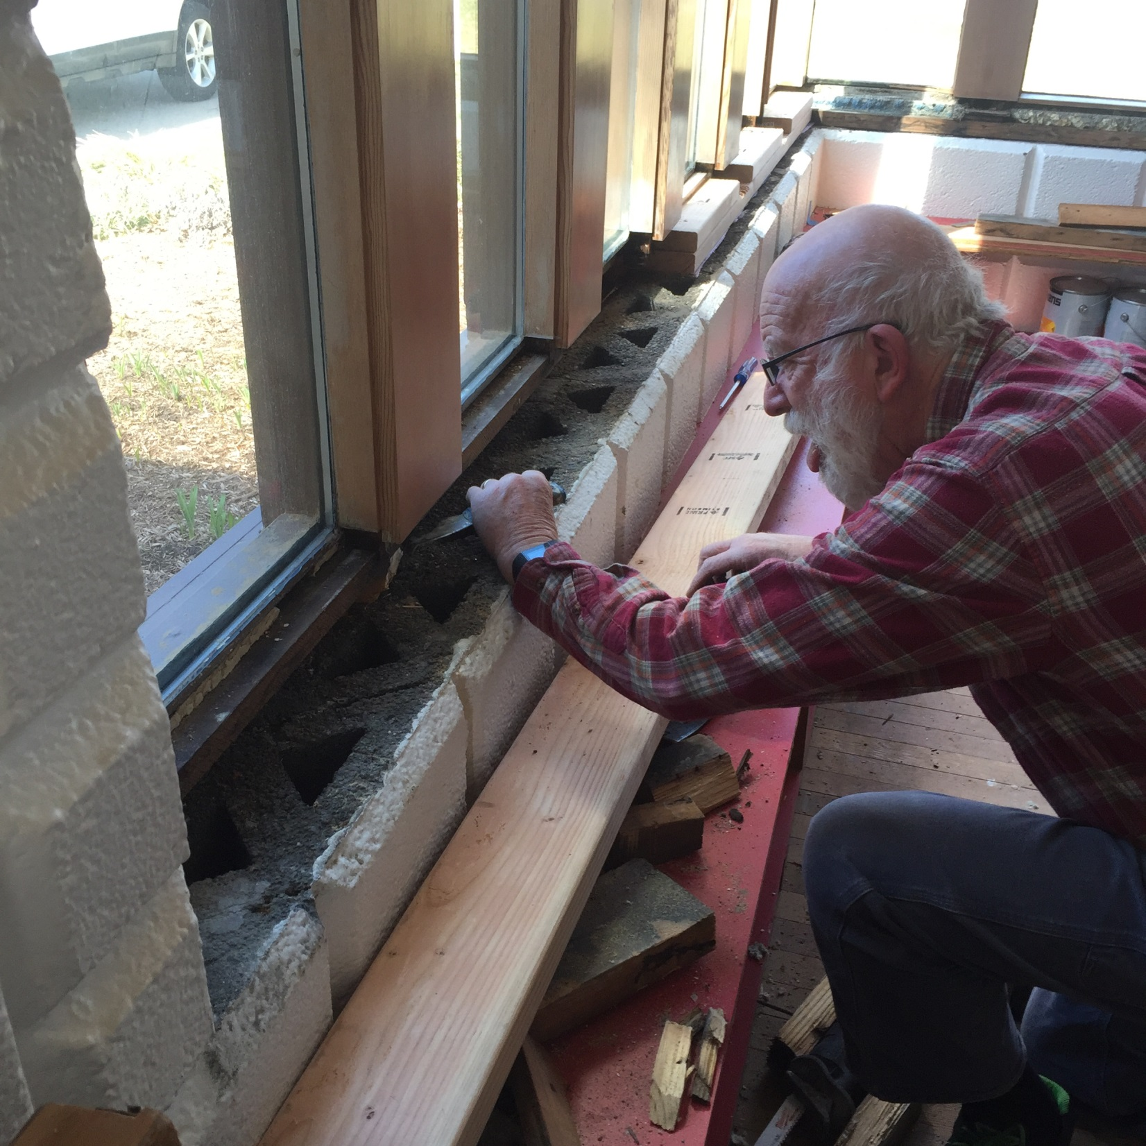

Slide 44
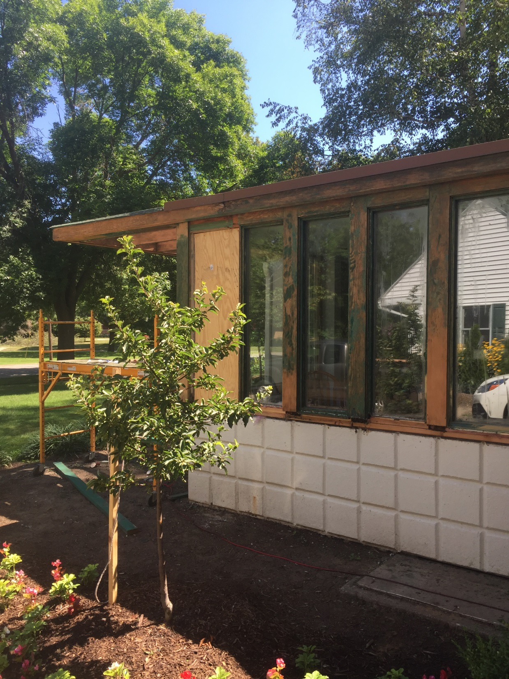

Slide 45
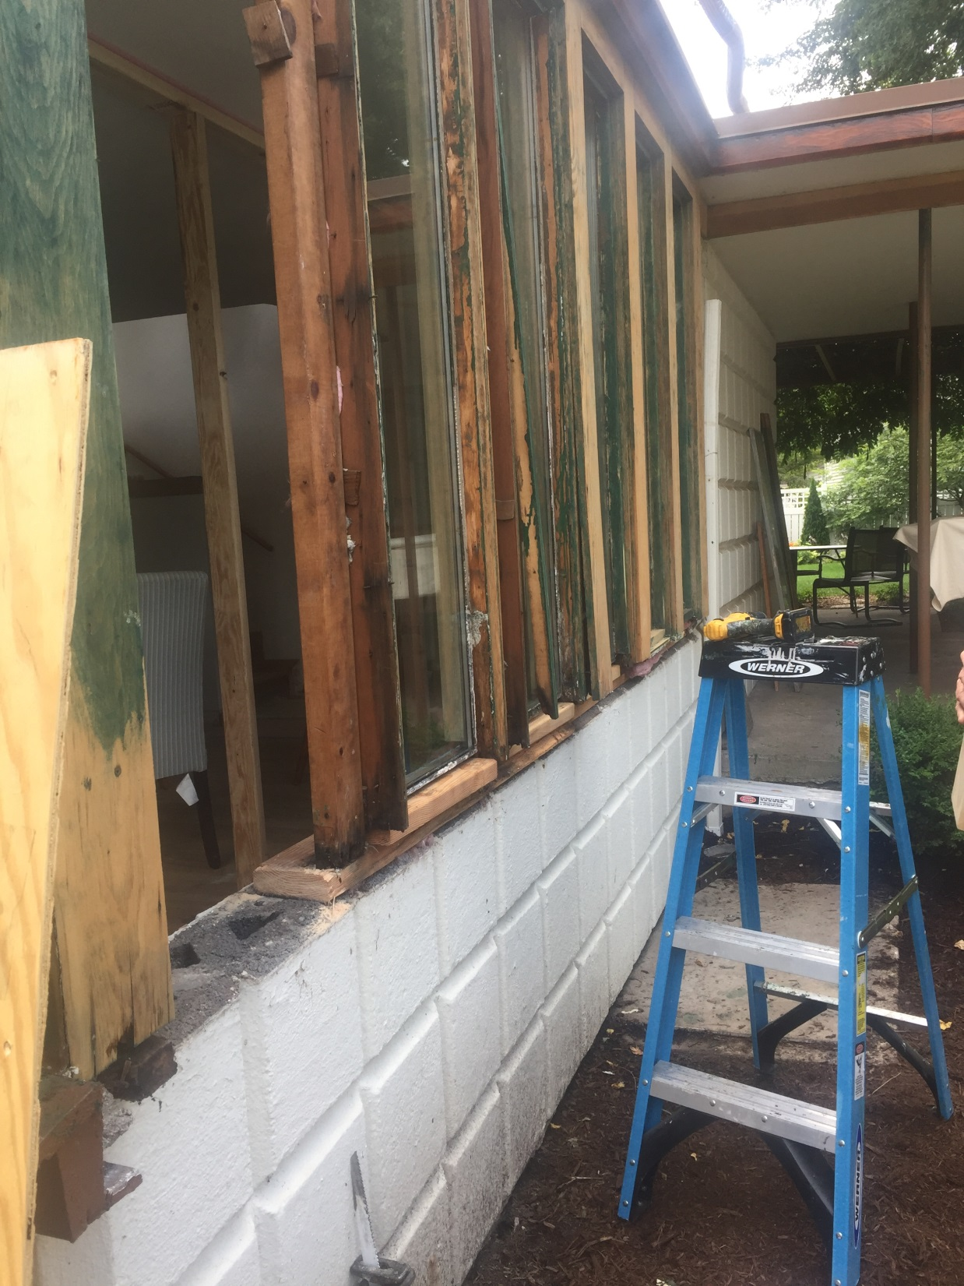

Slide 46
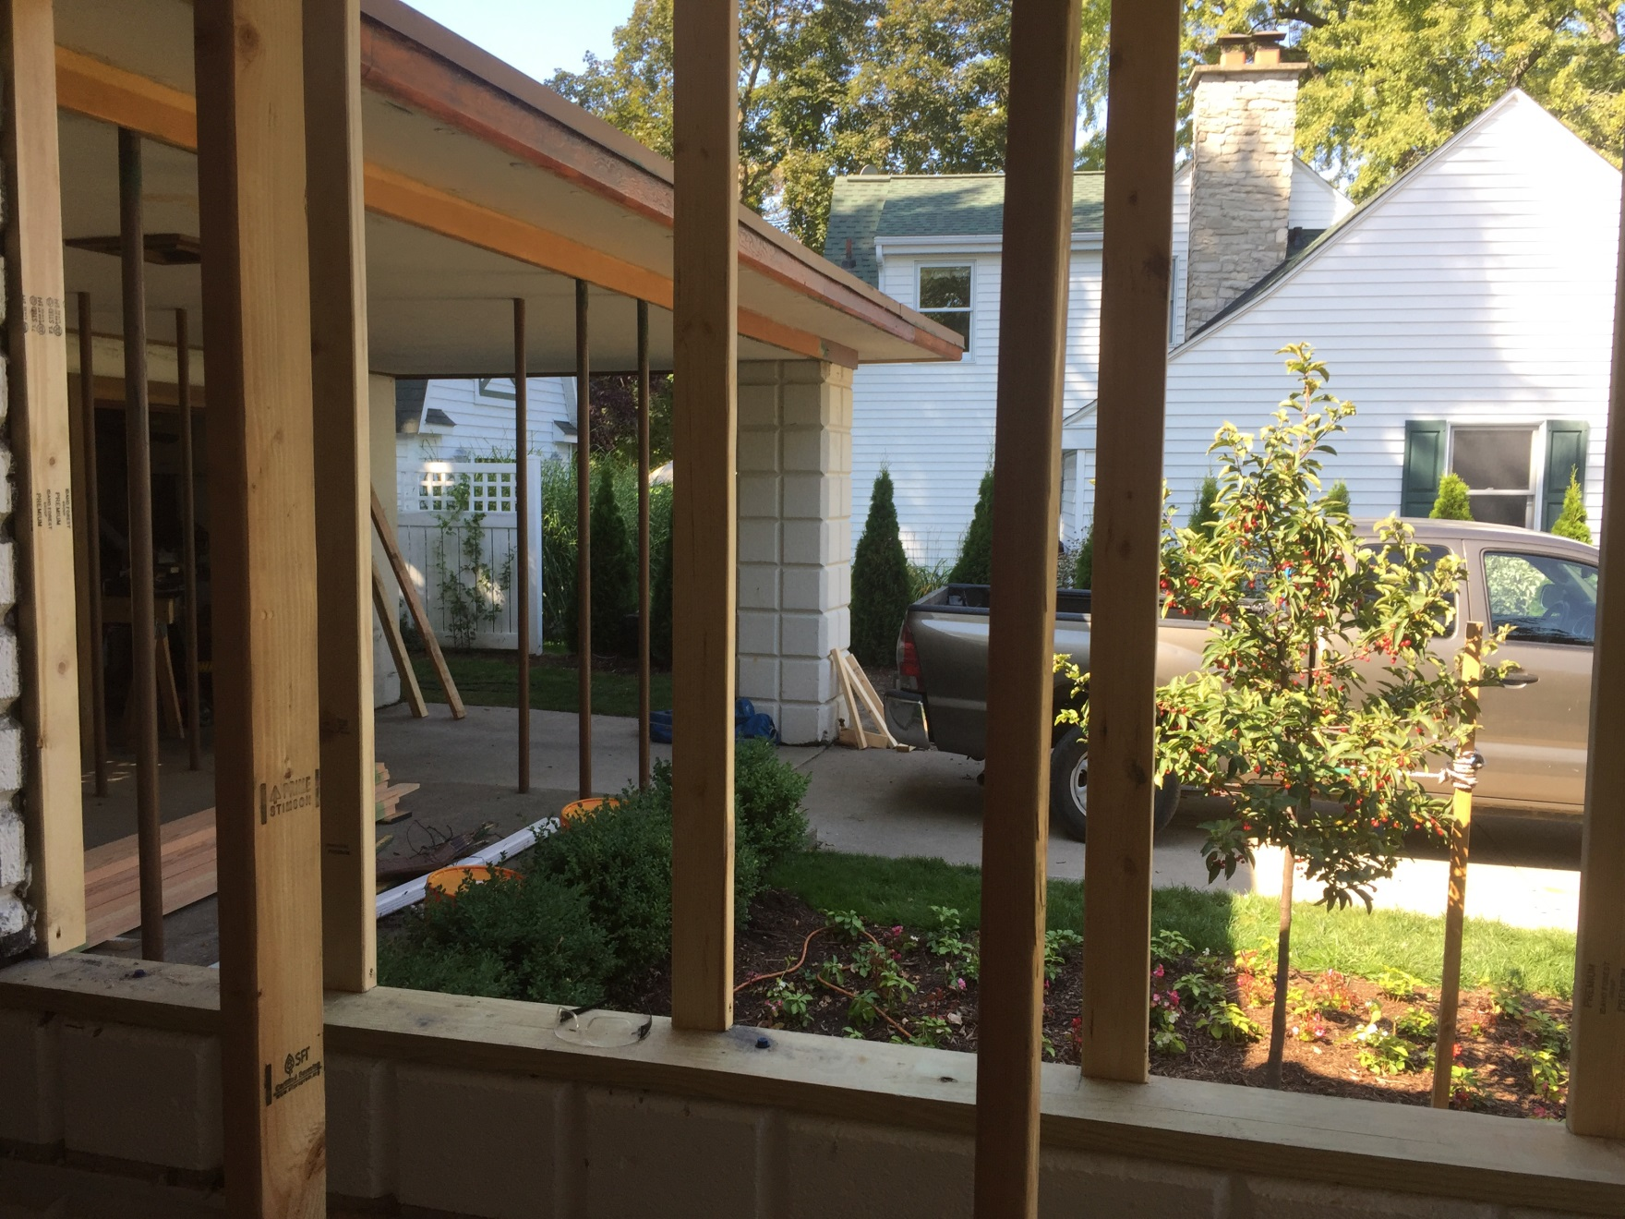

Slide 47
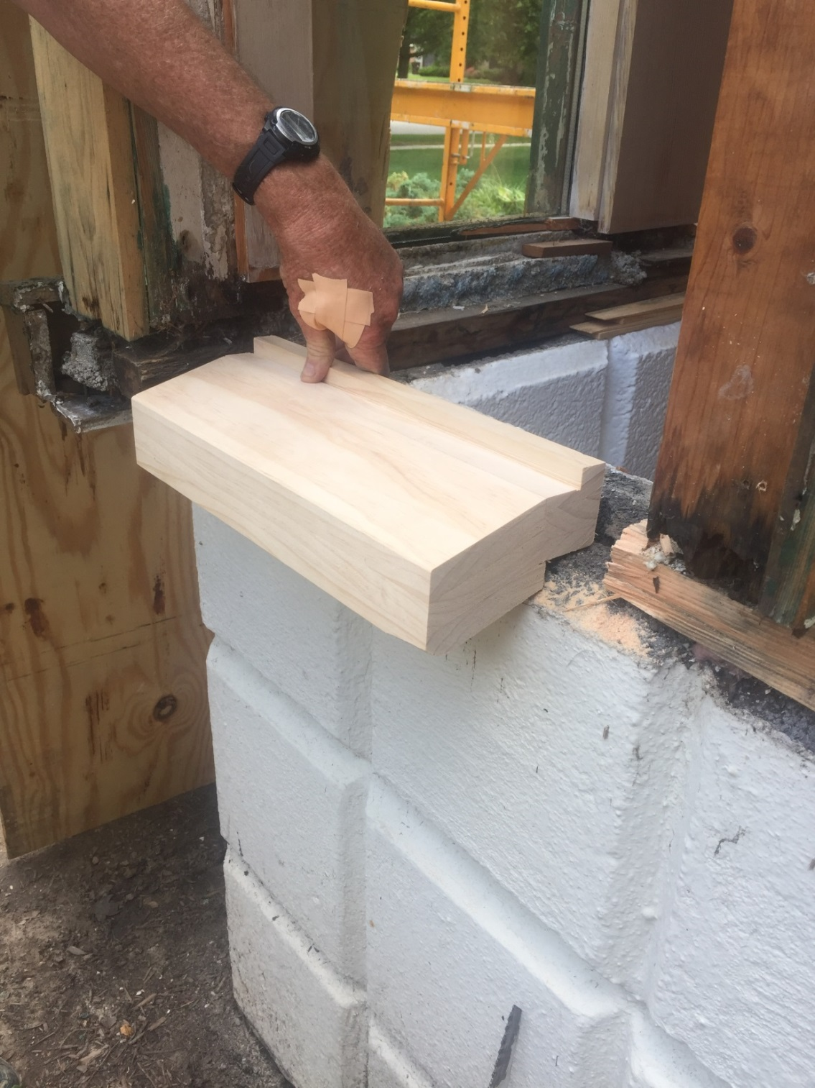

Slide 48
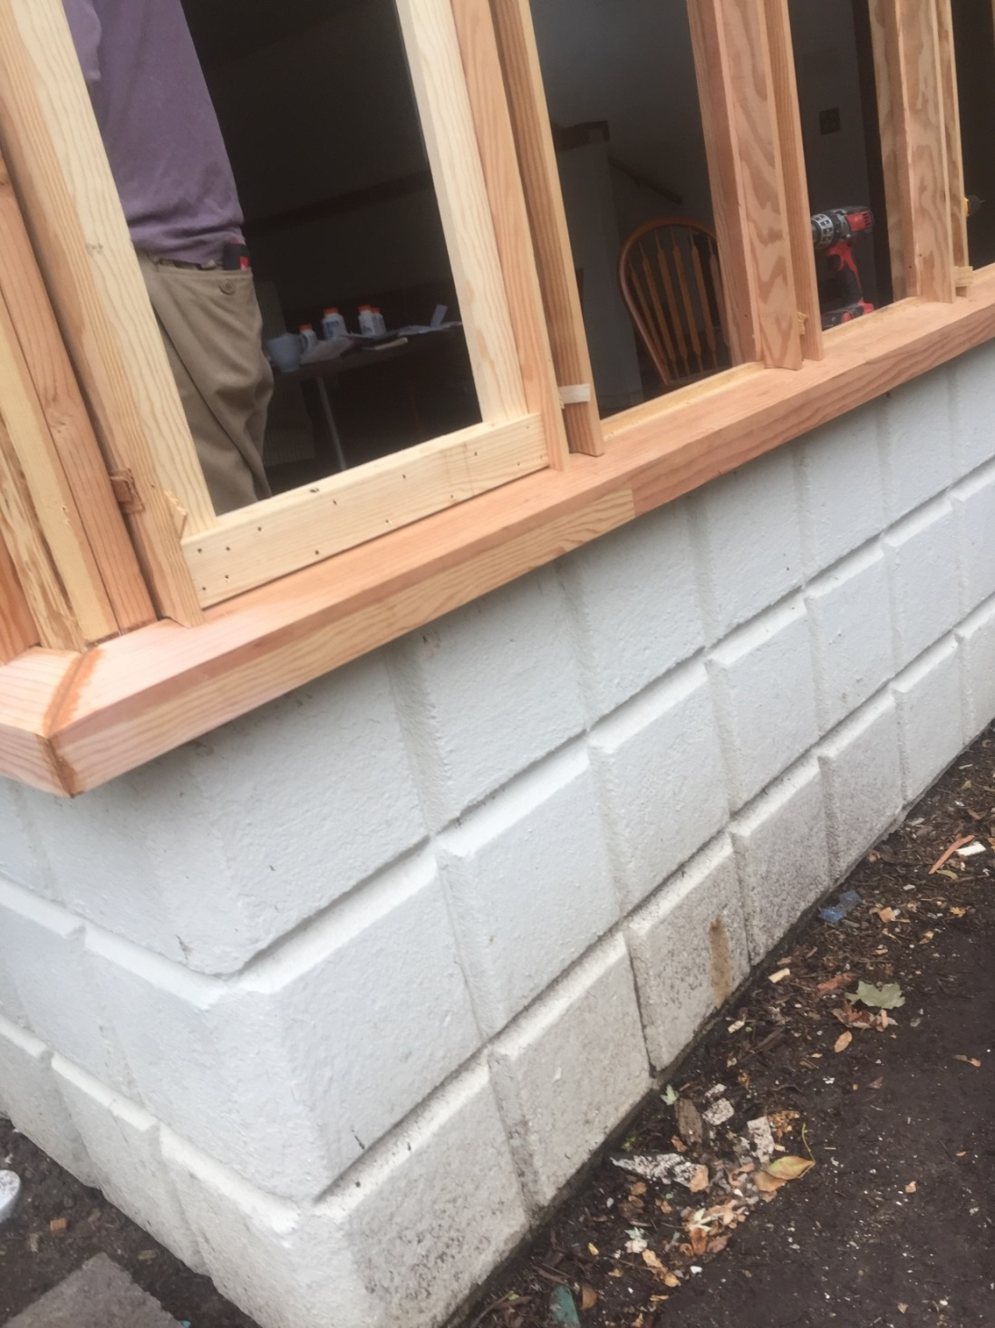

Slide 49
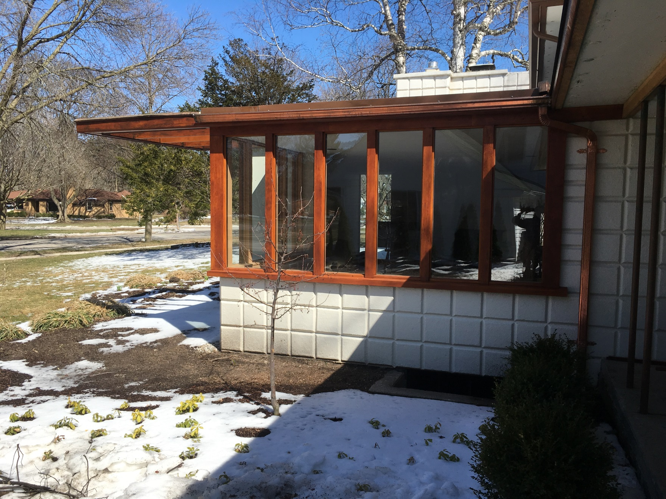

Slide 50
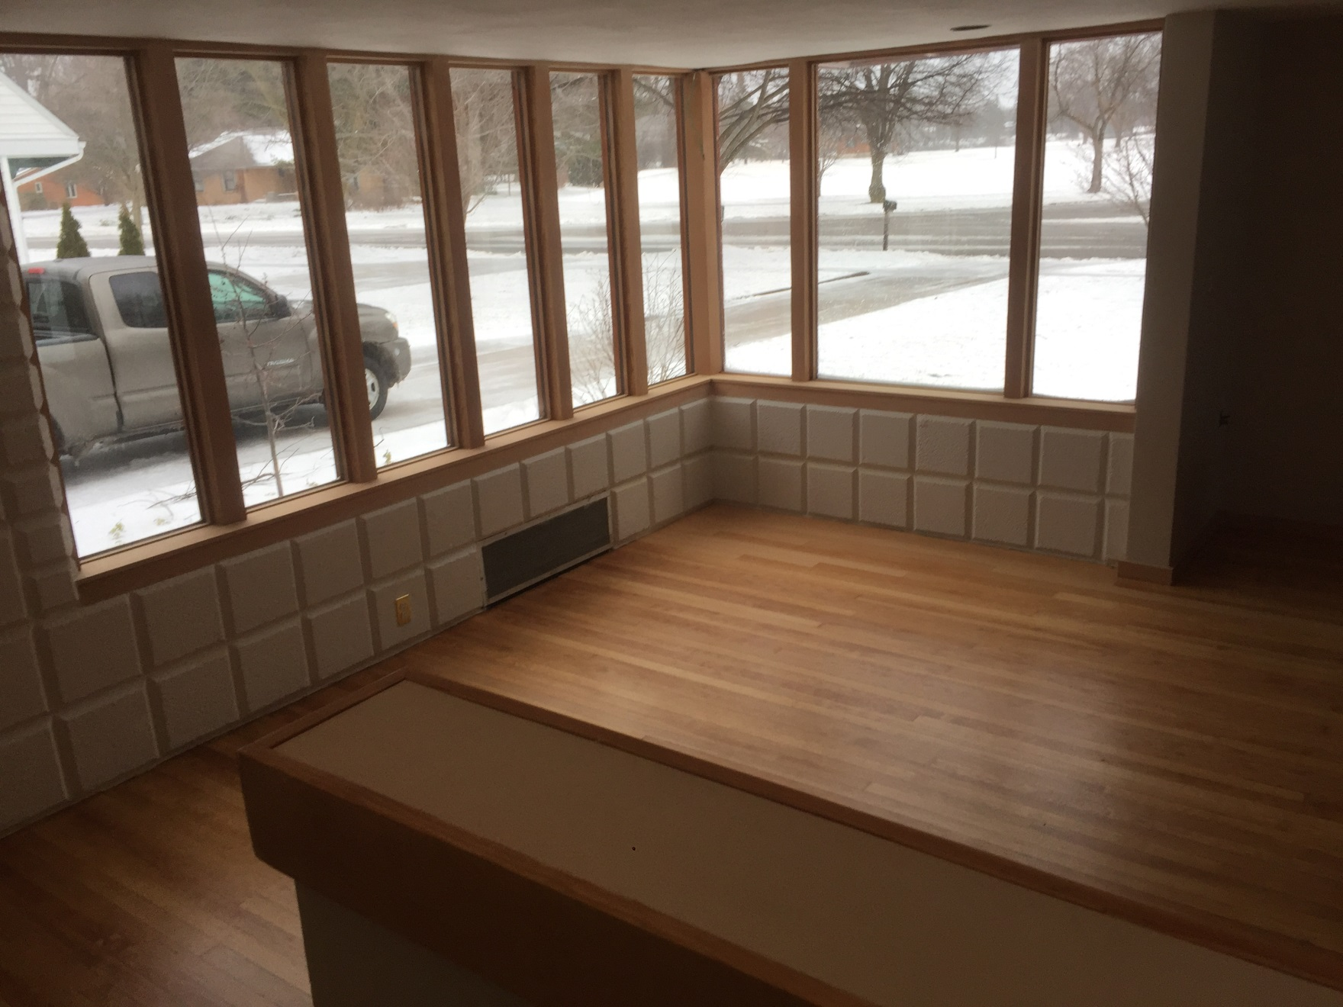

Slide 51
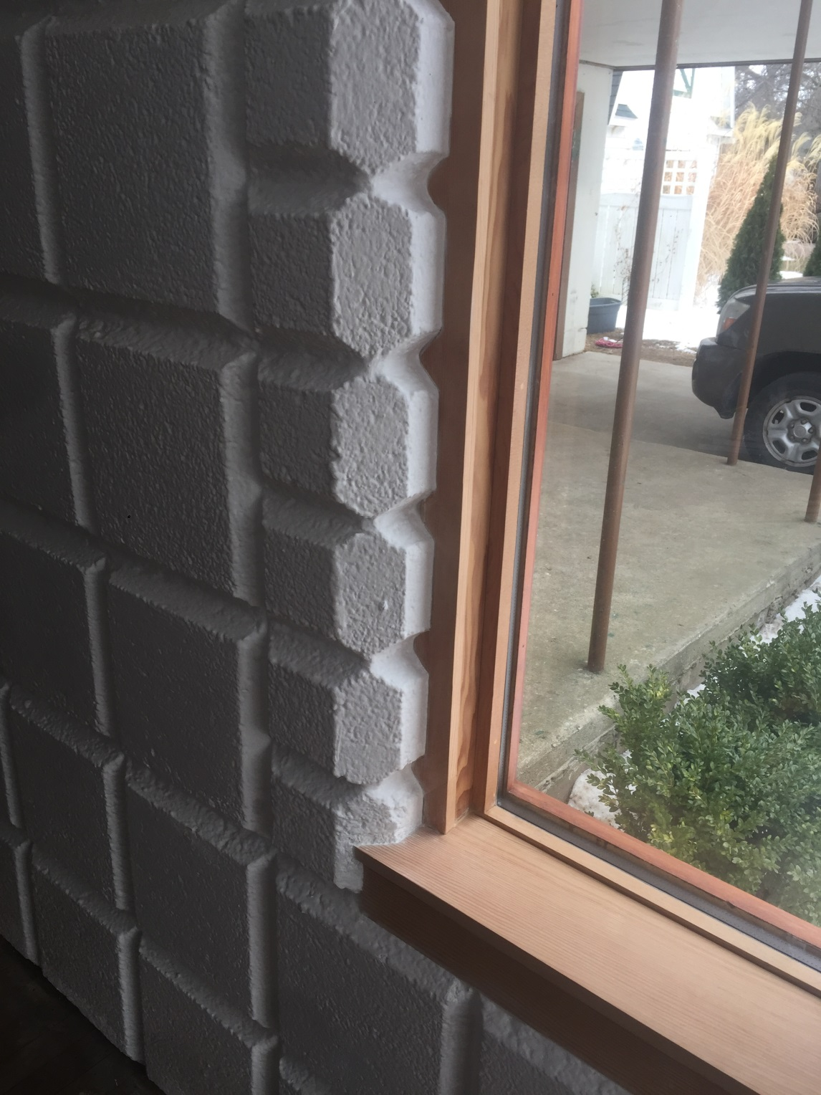

Slide 52
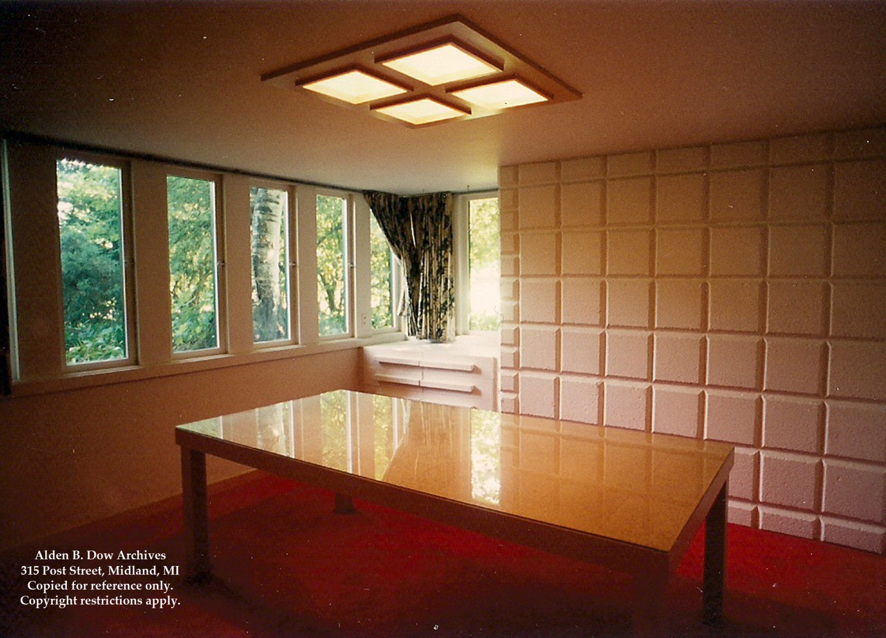
Dining Room

Slide 53
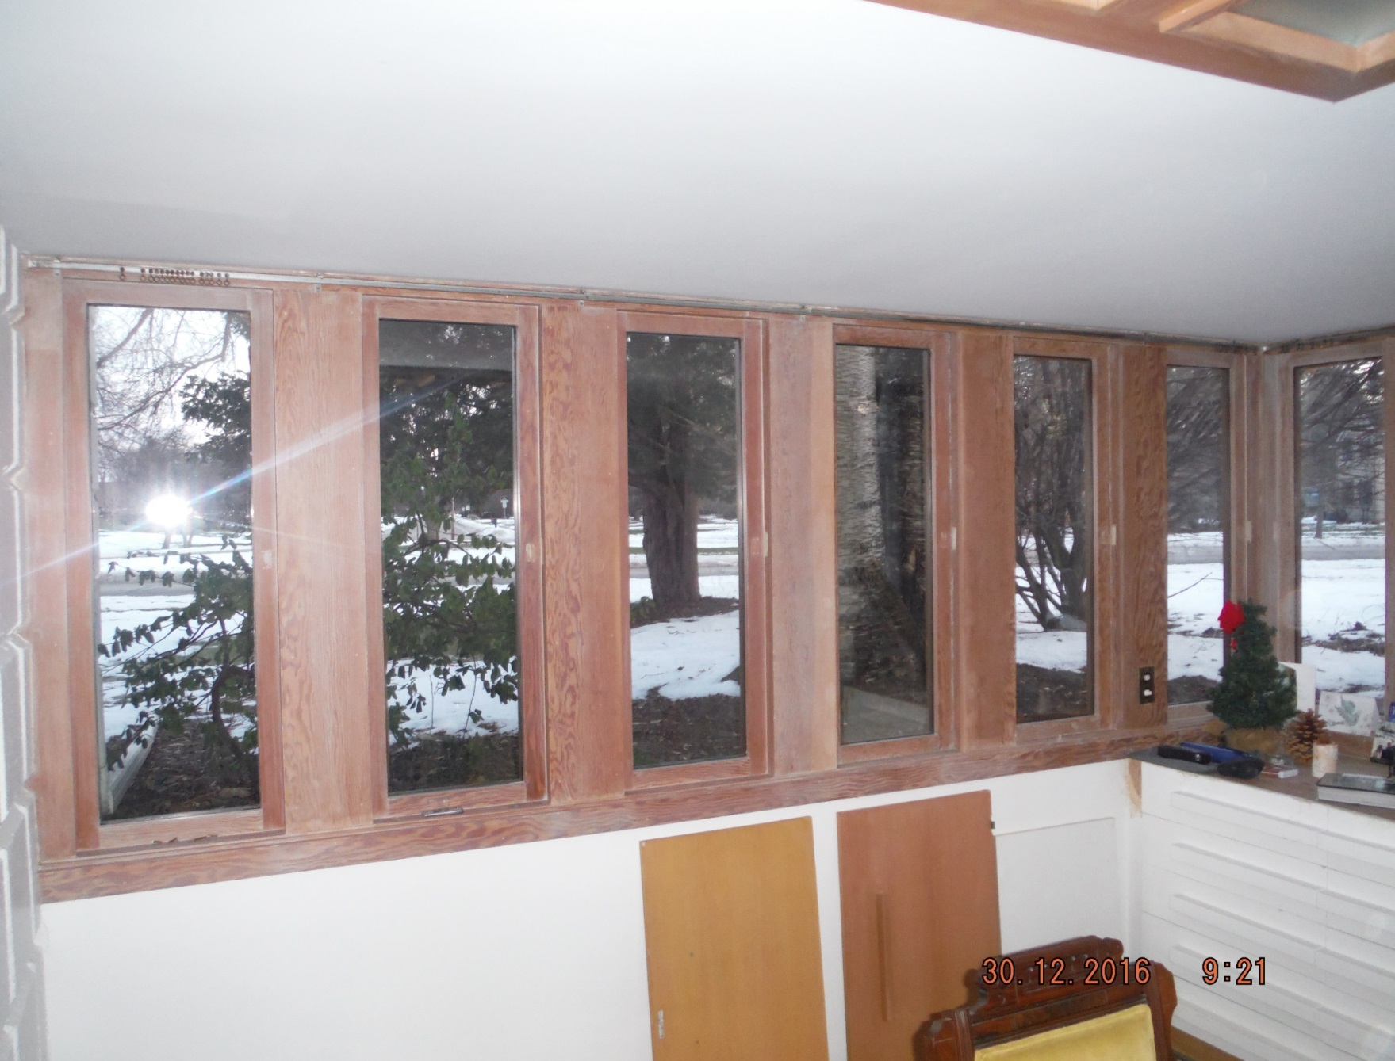

Slide 54
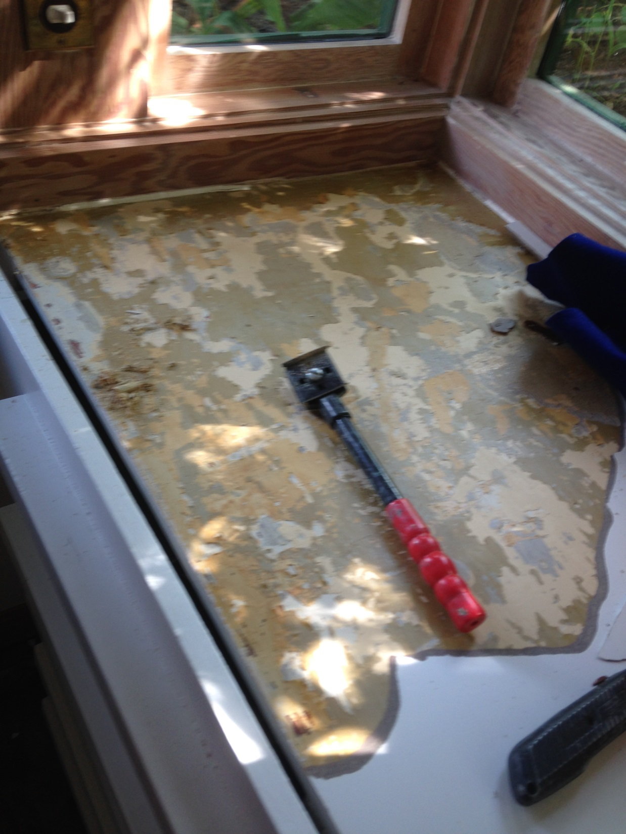

Slide 55
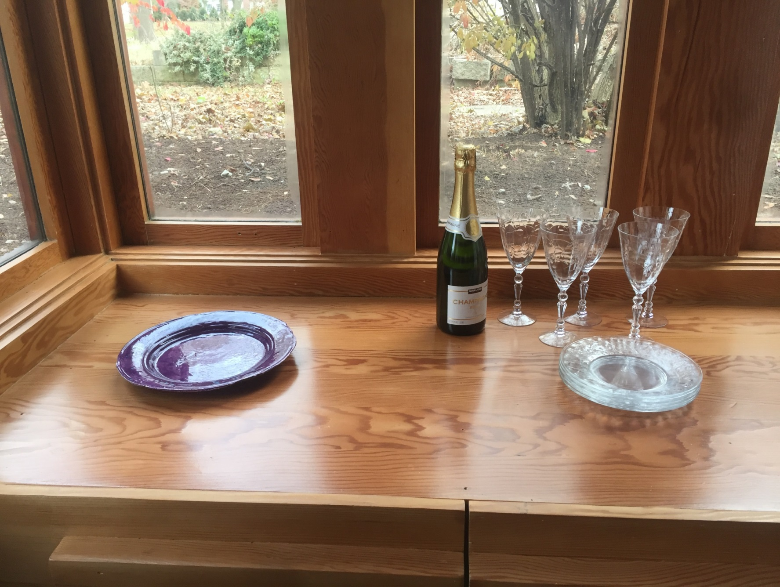

Slide 56
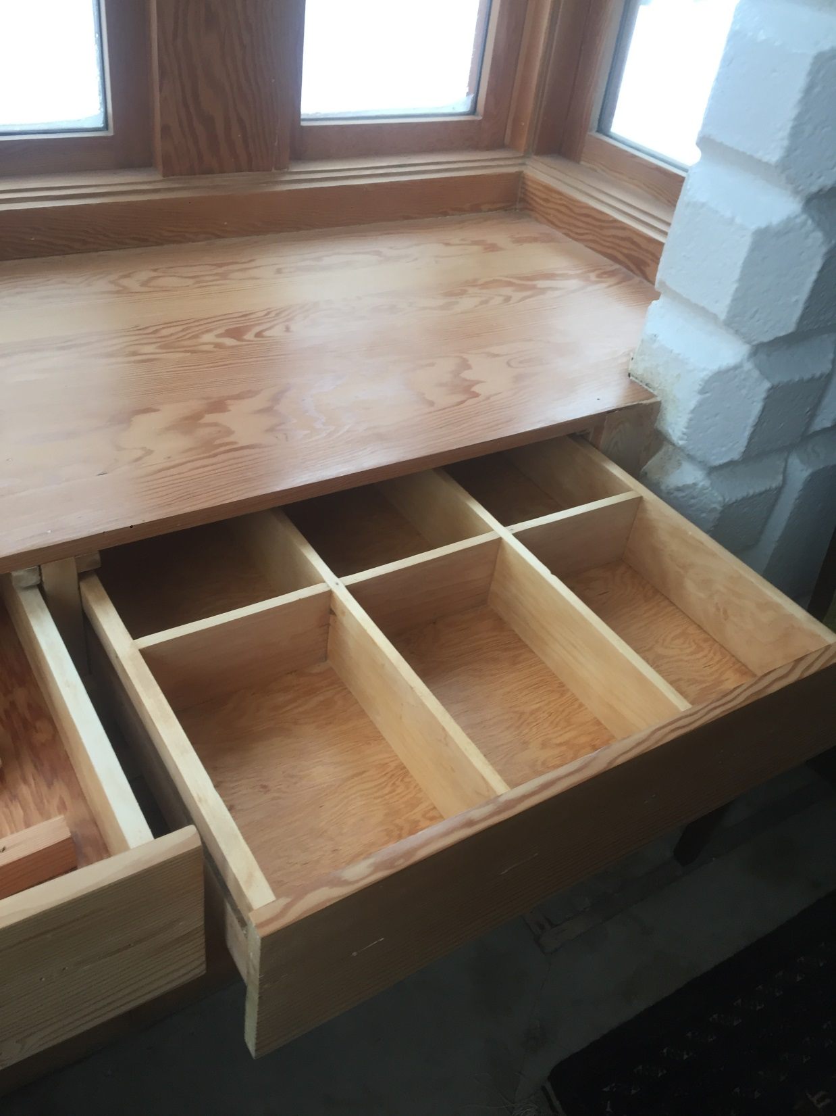

Slide 57
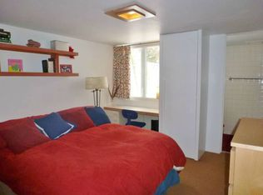
Den

Slide 58
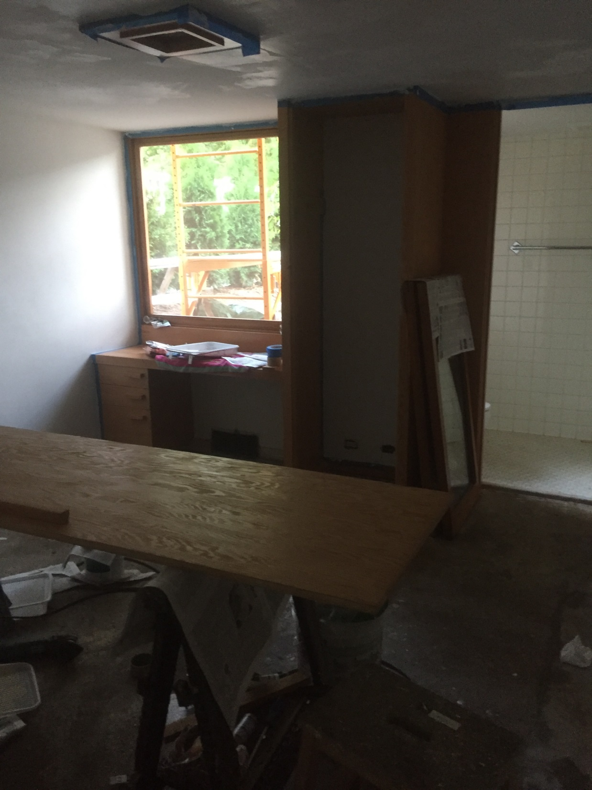

Slide 59
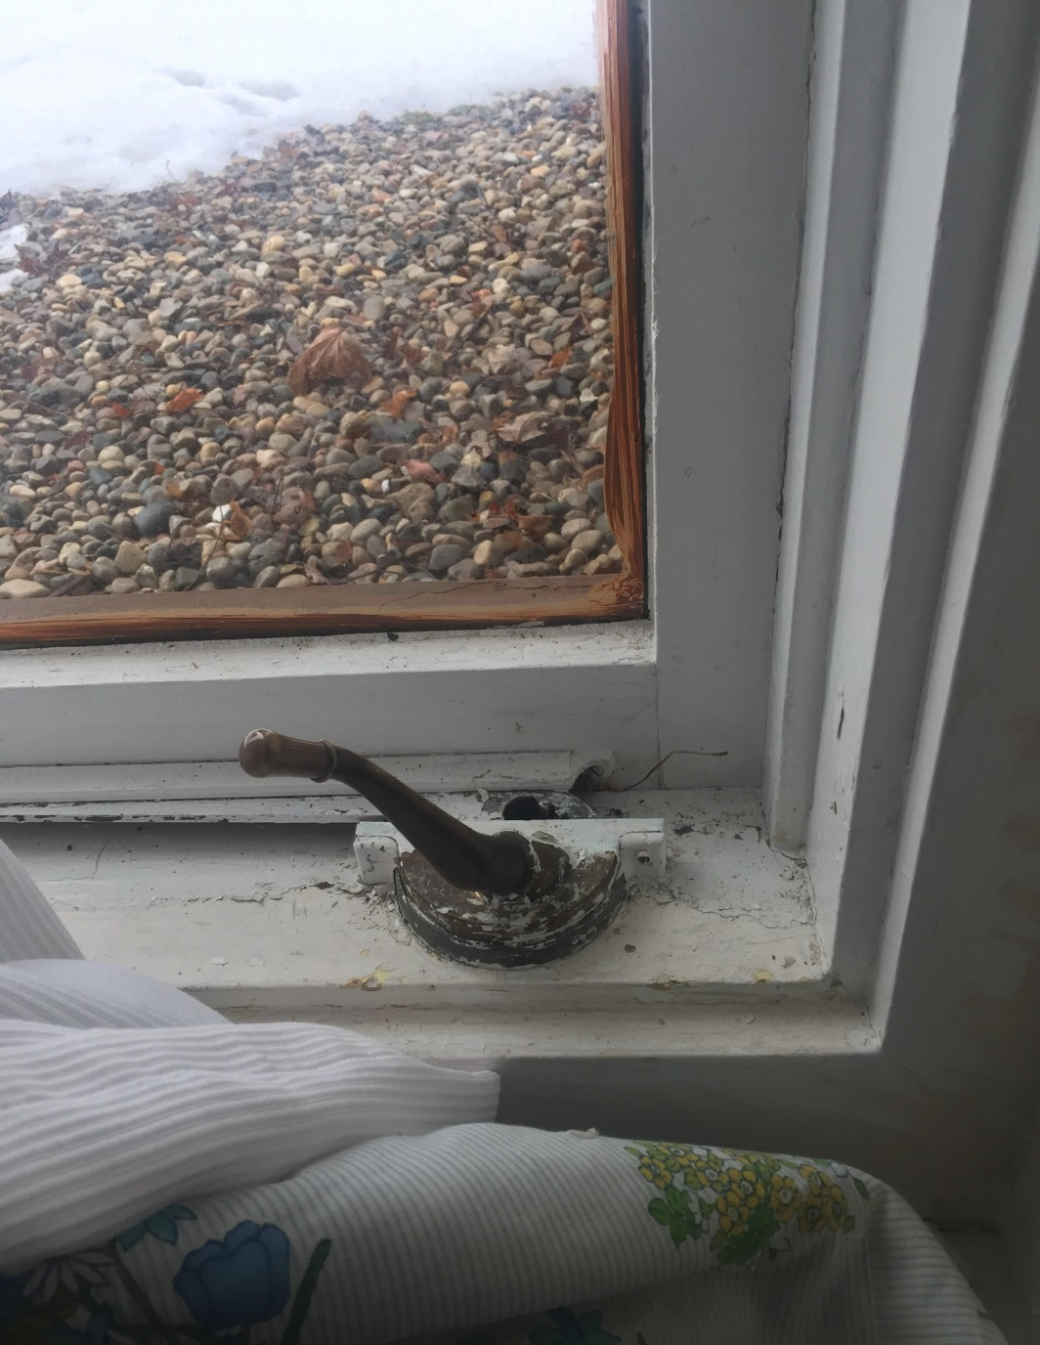
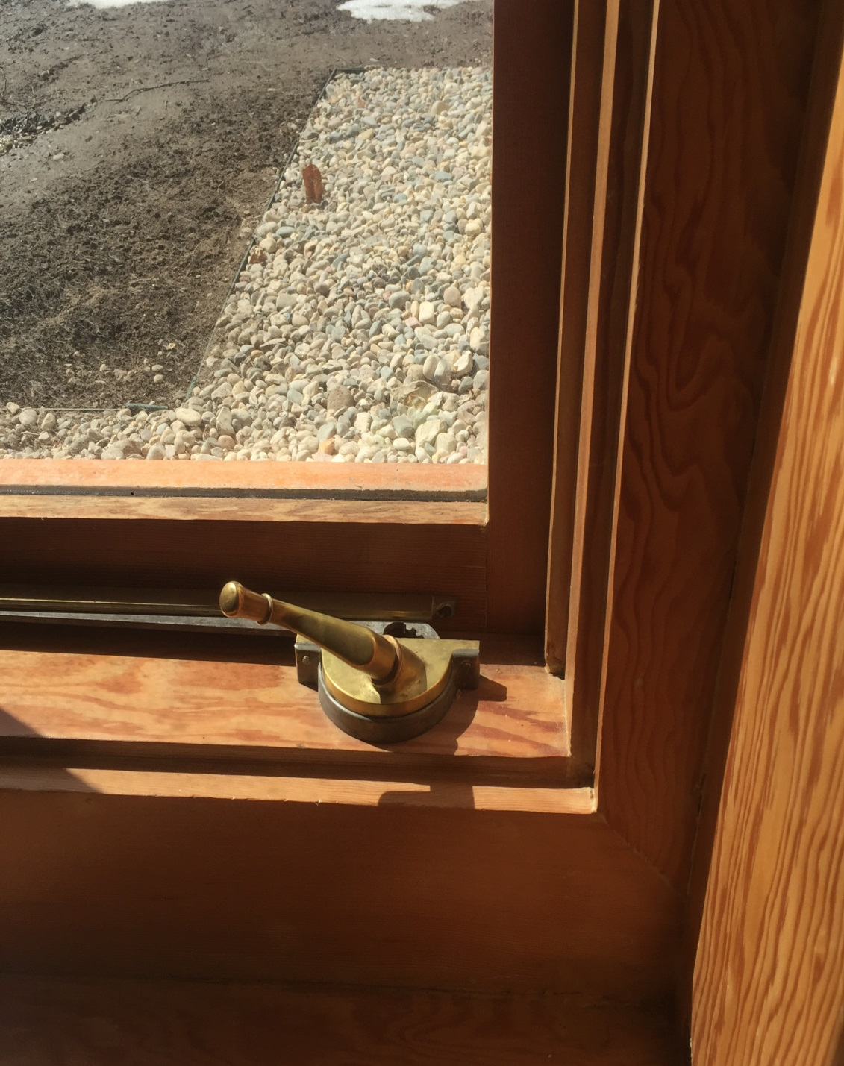

Slide 64
Kitchen

Slide 67
Exterior Work

Slide 68
Exterior Paint Removal Process
Start with JASCO Premium Paint and Epoxy Remover. About $29/gallon $1 cheaper at Lowes than Home Depot.
Paint it over the board and wait for it to bubble up, find your favorite stripping blade and scrape the paint (always wear gloves) into a cardboard box or onto newspaper. Don’t scrape too hard or you’ll gouge the wood.
The first couple coats come off one at a time unfortunately. Get down to almost bare wood .
Use Denatured Alcohol and fine steel wool or a brass brush to get remainder.
Sanded everything. Some of the green needed sanding with 40 grit although it is hard to remove every sanding mark if you use this grit. It does get all the paint, though.
Most painters recommend starting with 80 grit then go up to 180 or 220 before applying polyurethane.

Slide 69
Exterior Paint Refinishing Process
You should dust the sawdust off the surface between grit changes.
I like my Makita orbital sander best, just need to replace the pads every few months. Festool makes a nice ($$$$$) detail sander . Which I’ve used a lot also
For the finish we used what the Home and Studio uses a Sikkens Cetol Teak for the first coat and then Cetol 23 Plus RE for the top coat. Both are sold at ACE Hardware
The Cetol 23 Plus RE is a maintenance coat that needs to be re-applied every 2-3 years.
I relied heavily on the list of vendors from the Home and Studio for advice. Howell Painting was particularly helpful. He visited our home a couple of times and reinforced that we using the right methods
Most of the other vendors from that list were very willing to volunteer their time to come look at our work.

Slide 90
Questions

